Slide 1
Transcription and Translation
AP Biology
Mr. LaTorre

Slide 2
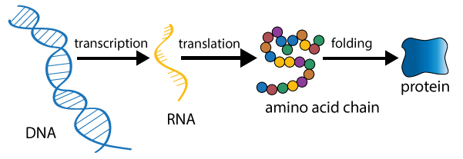
Gene Expression
Gene expression is the molecular process of reading the order of nucleotides in a DNA molecule and making the coded product
Gene expression occurs whenever a specific protein or RNA molecule is needed by the cell.

Slide 3
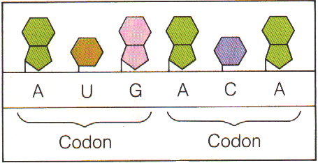
Codons
The mRNA “message” is read in 3-letter words called codons. Each codon codes for an amino acid or tells the process to stop.
There are 64 codons but only 20 amino acids. Some codons code for the same amino acid.

Slide 4
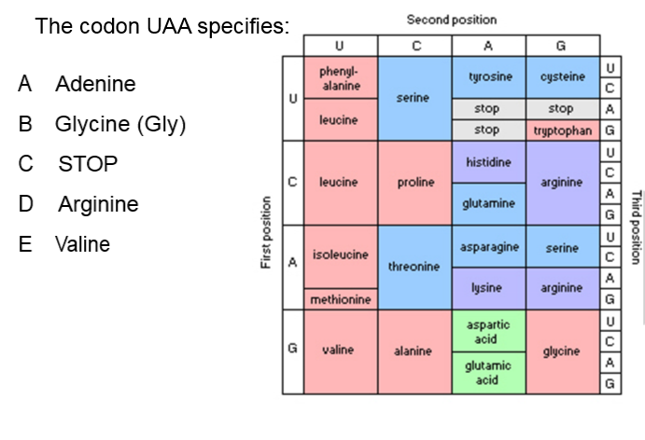

Slide 6
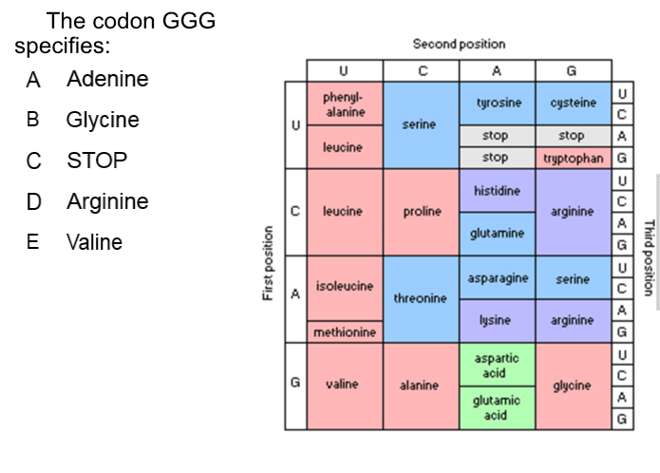

Slide 8
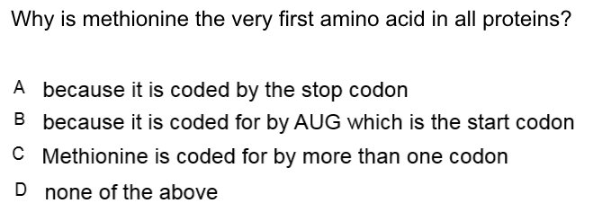

Slide 10
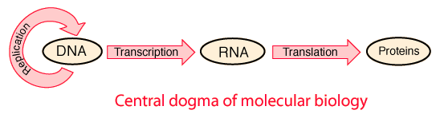
The Central Dogma
The process of replication, transcription and translation are so critical that they are called the Central Dogma of Biology.

Slide 11
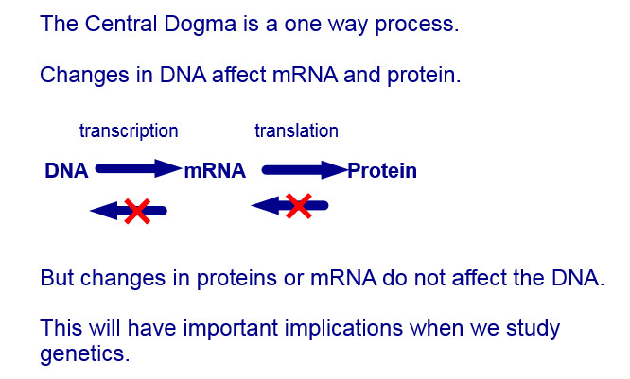

Slide 12
Transcription- Step 1
A particular DNA segment is transcribed into RNA, by the enzyme RNA polymerase.
Transcription of genes is regulated by the cell. Genes are turned on and off in response to environmental signals. (Signal Transduction Pathways)

Slide 13
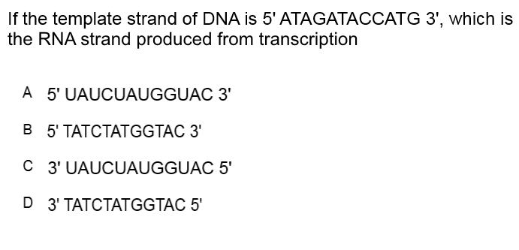

Slide 15
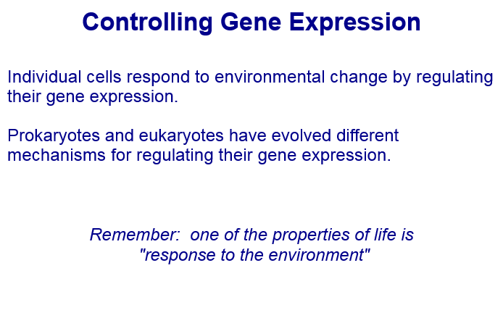
Genes = 50%
Circumstances = 10%
Intentional Behavior = 40%

Slide 16
mRNA Processing
After transcription, the transcript is known as pre-mRNA. Enzymes in the nucleus modify the pre-mRNA before genetic messages are sent to the cytoplasm. This is known as mRNA processing.
During mRNA processing both ends of the pre-mRNA are altered.
Some interior pieces may be cut out, and other spliced together.
“Like editing a movie”
https://www.youtube.com/watch?v=itsb2SqR-R0
(5:40-10:50) Crash Course

Slide 17
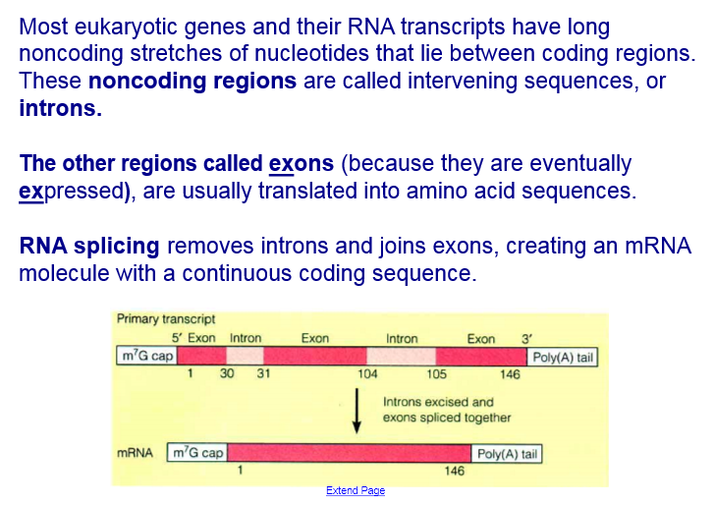
RNA Splicing

Slide 18
Translation
Translation is the process by which RNA strands are read to build proteins.
Translation requires 3 types of RNA that are created using transcription.
1. mRNA or messenger RNA carries the information for protein synthesis.
2. rRNA or ribosomal RNA is a catalyst for protein synthesis.
tRNA or transfer RNA, helps in the assembly of amino acids during protein synthesis.

Slide 19
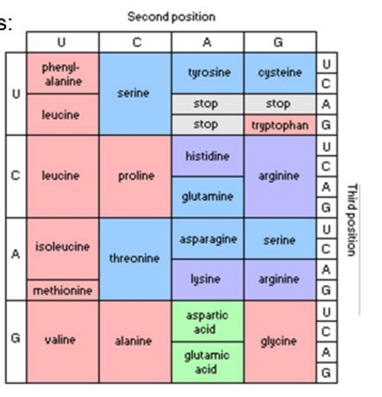
Create
Create a DNA chain using the 4 bases that can be transcribed into all 20 amino acids.
DNA
RNA
Amino Acid

