Slide 1
Membranes & Proteins
AP Biology Unit 2
Mr. LaTorre
Millville Senior High School

Slide 2
Membranes & Proteins
Cell Membranes
Transport Proteins
Signaling Proteins
Enzymatic Proteins

Slide 3
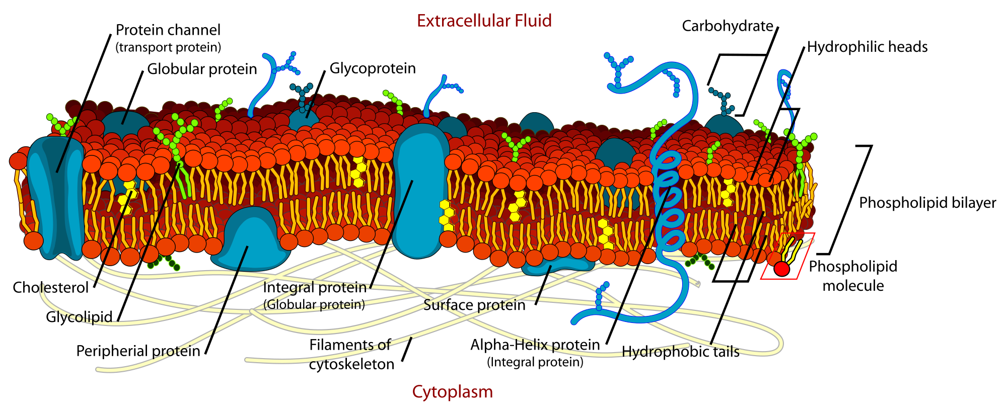
Cell Membranes

Slide 4
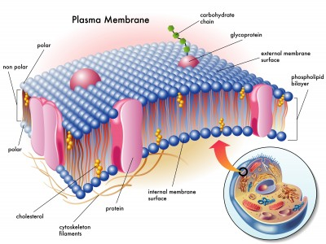
Biological Membranes
The term membrane most commonly refers to a thin, film-like structure that separates two fluids.
Membranes act as a container for biological systems, surrounding protobionts, cells, and organelles.

Slide 5
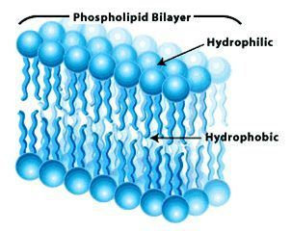
Phospholipids
Lipid= fats
Composes the majority of biological membranes
Their amphiphilic nature causes them to naturally form a spherical bilayer (*both hydrophilic and hydrophobic)

Slide 6
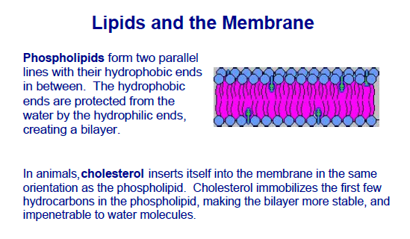

Slide 7
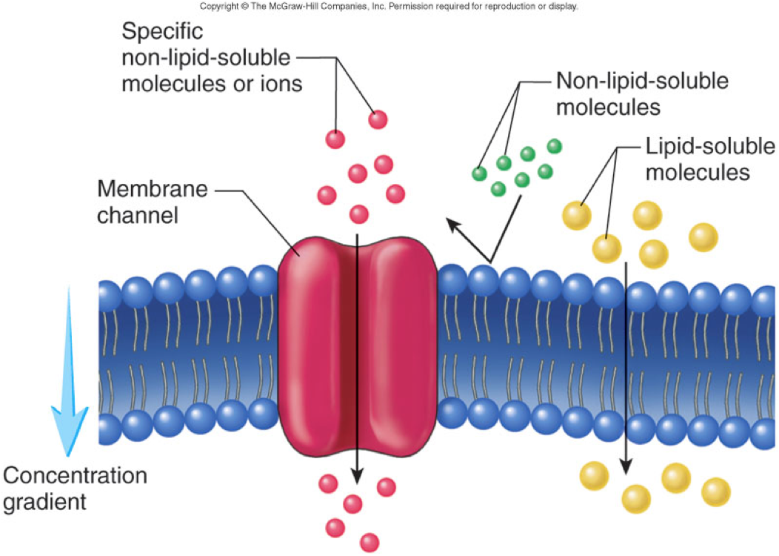
Selective Permeability
Membranes act as selectively permeable barriers, allowing some particles or chemicals to pass through, but not others.
The properties of the phospholipid bilayer dictate what can pass through a membrane.

Slide 8
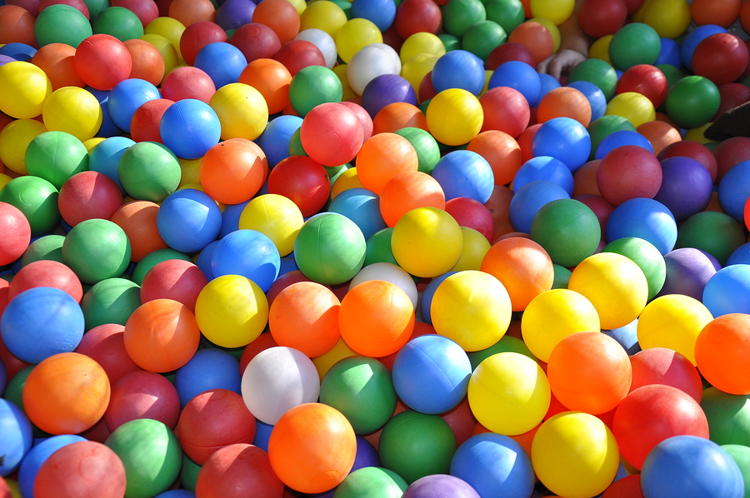
Selective Permeability
When phospholipids come together, they create a wall that is tightly packed with a core that is nonpolar. However, the individual molecules are not fixed and small gaps form as they fluidly move around the membrane.
“Like a ball pit?”

Slide 9
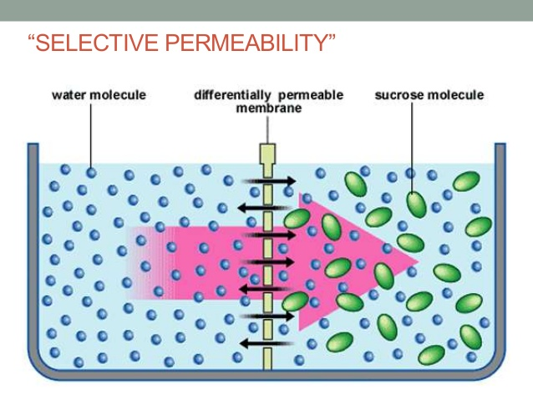
Selective Permeability
What kind of molecules can pass through a membrane made of just phospholipids?
Small
Non-charged
Oxygen
Water

Slide 10
Osmosis
Water can easily pass through a membrane and balance out the membrane potential (charge) of the cell.
“Making Iced Tea”
Osmosis is the spontaneous net movement of solvent molecules through a semi-permeable membrane into a region of higher solute concentration, in the direction that tends to equalize the solute concentrations on the two sides.

Slide 11
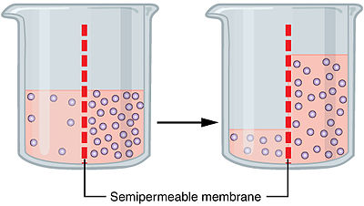
Osmosis

Slide 12
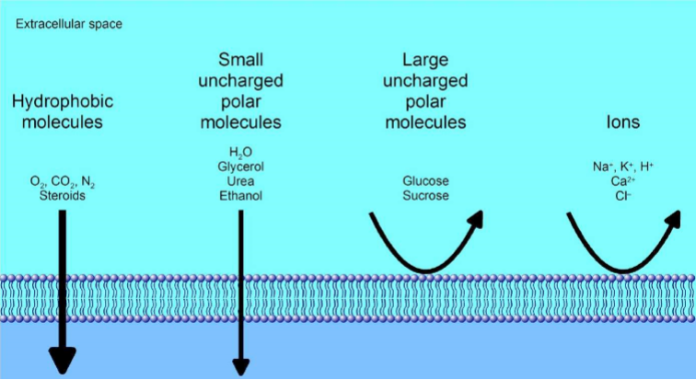
Selective Permeability
Large molecules or charged molecules will not make it through a lipid bilayer.
Some examples: sugars, ions (charged particles), nucleic acids, proteins

Slide 13
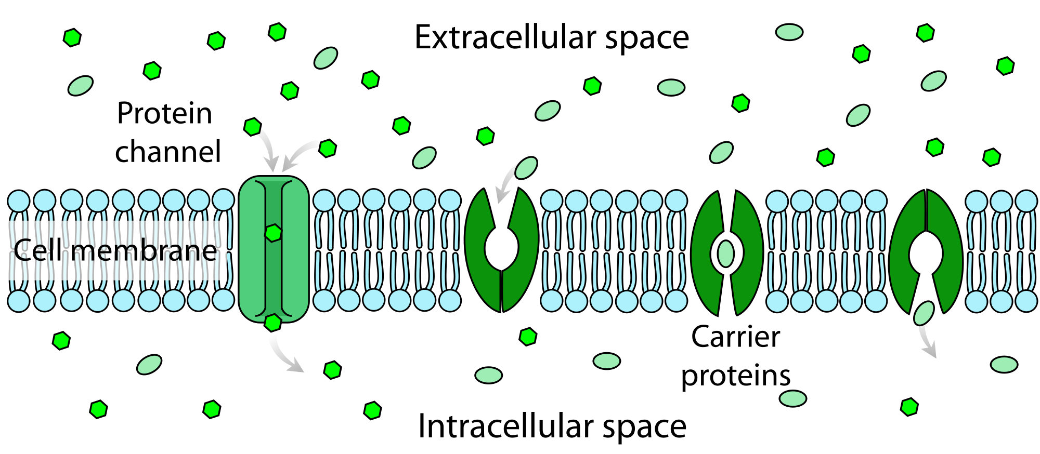
How do cells get what they need?
Cells require things such as sugar, nucleic acids, proteins and sodium; and these cannot pass through the lipid bilayer.
“Cells prefer to remain in a state of equilibrium (balance). This is why they need to let things in and out.”
So how do cells get what they need?

Slide 14
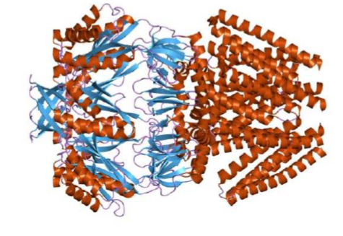
Membrane/ Transport Proteins
Proteins embedded in the cell membrane facilitate the movement of large or charged molecules through the barrier.
“Think of them as hallways and doorways”
Proteins are long chains of amino acids that fold onto each other to form biological systems.

Slide 15
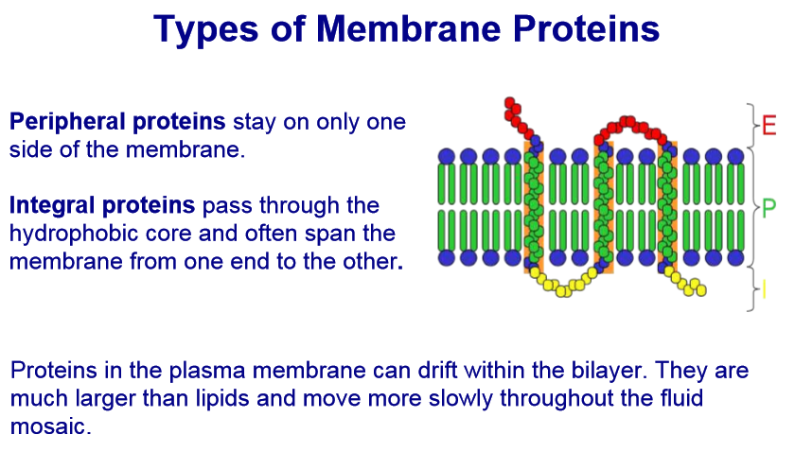

Slide 16
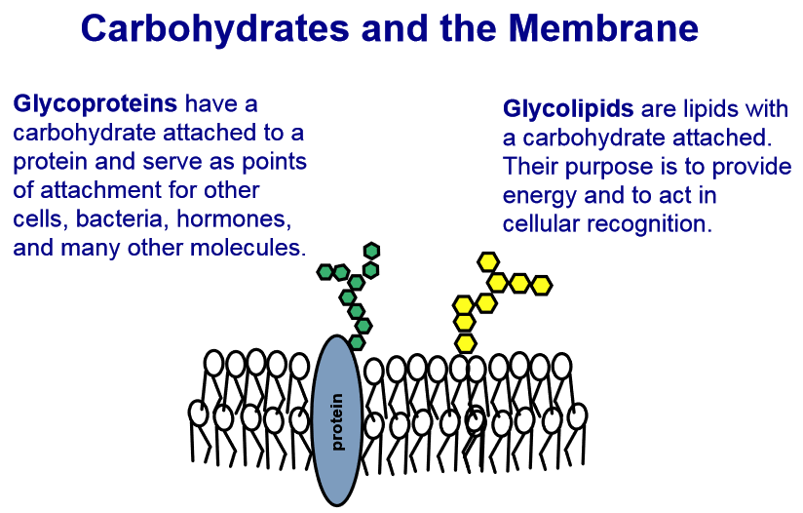

Slide 17
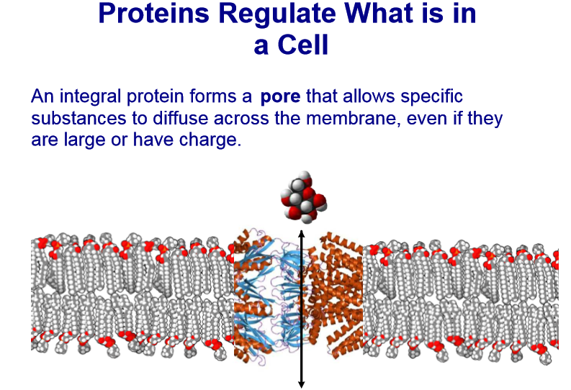

Slide 18
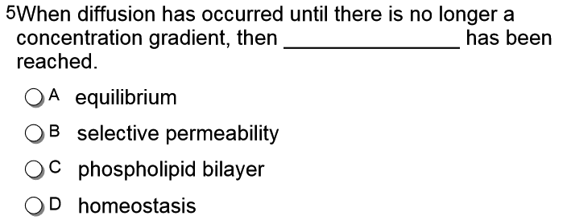

Slide 20
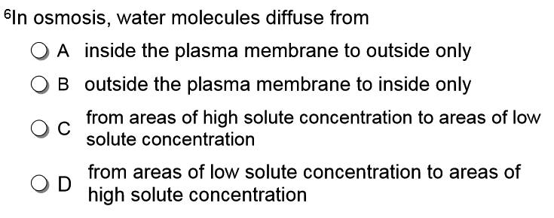

Slide 22
Slides #4-31
Draw a fluid mosaic model. Identify the key components.
List 2 things that could pass through a plasma membrane and 2 things that cannot.
Explain the difference between peripheral and integral proteins.
Explain the difference between glycoproteins and glycolipids.
For Tomorrow: Define hypertonic, hypotonic, and isotonic.

