Slide 1
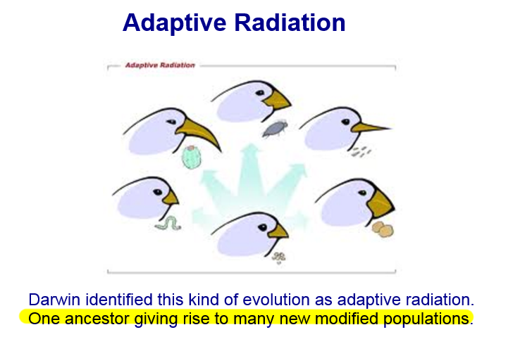

Slide 2
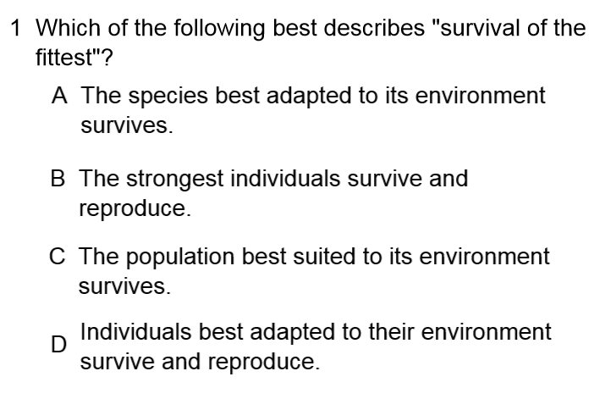

Slide 4
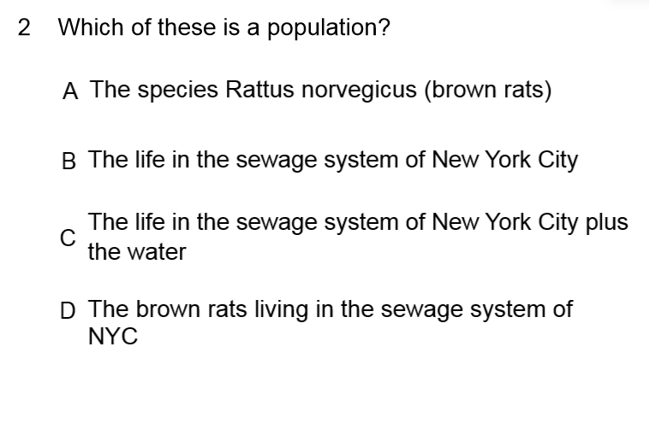

Slide 6
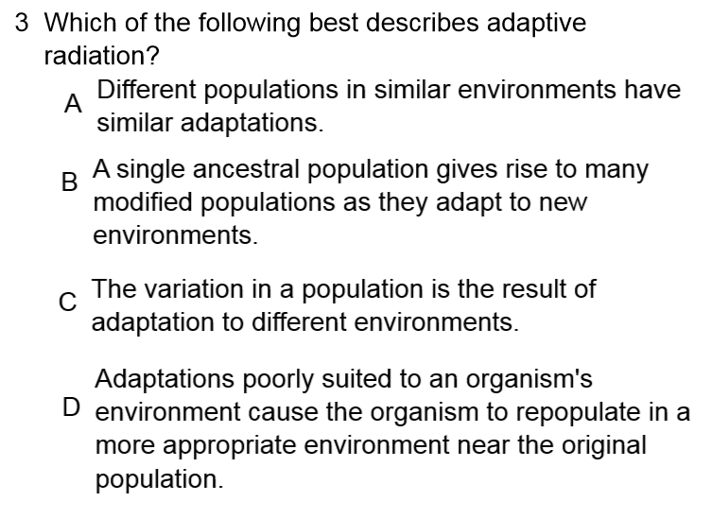

Slide 8
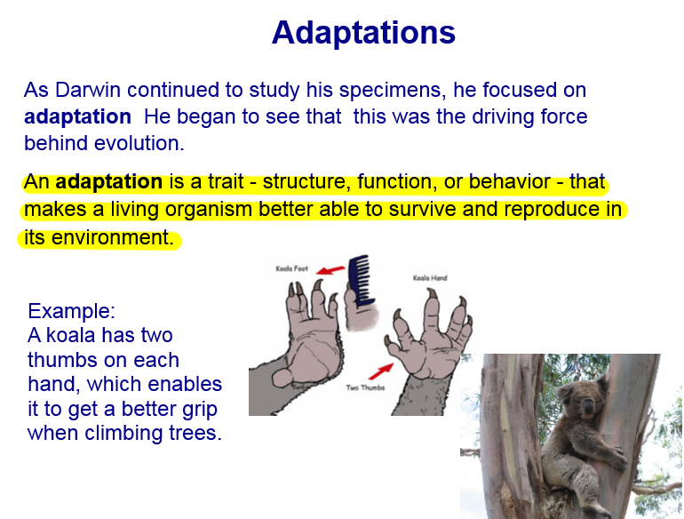

Slide 9
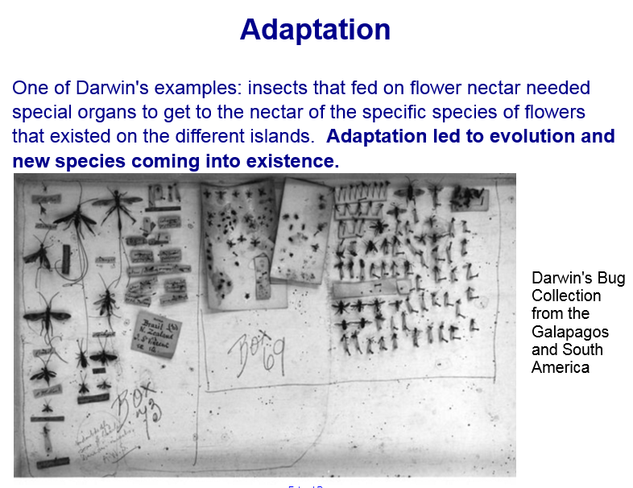

Slide 10
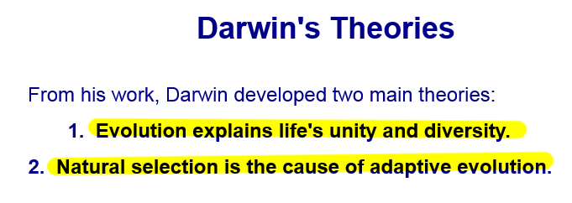

Slide 11
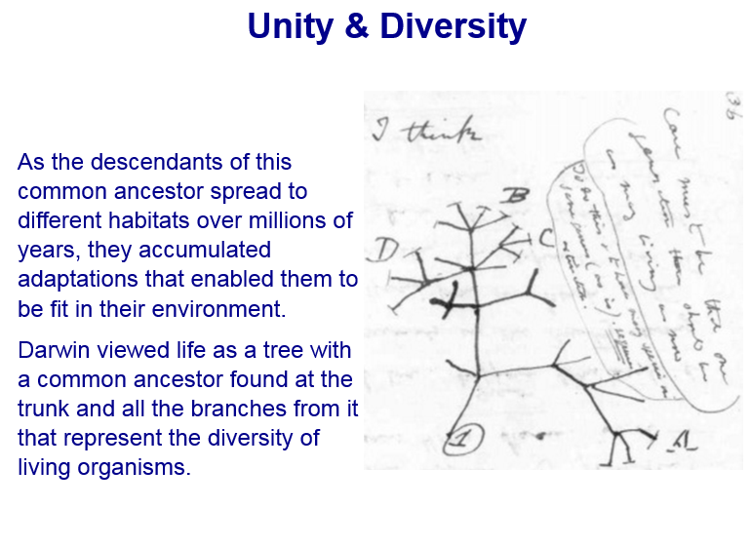

Slide 12
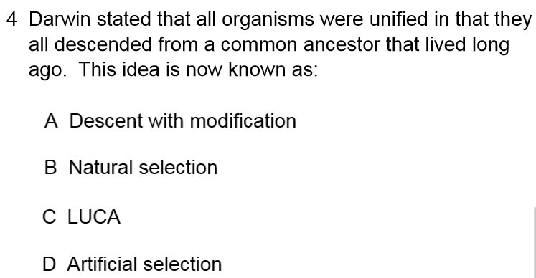

Slide 14
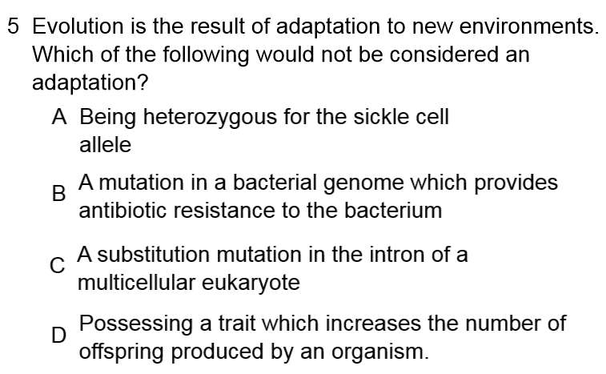

Slide 16
Classwork Questions
Distinguish between artificial selection and natural selection.
Explain why an individual organism cannot evolve.
Define genetic drift, the bottleneck effect, and the founder effect.
Distinguish among directional , disruptive, and stabilizing selection.
List four reasons why natural selection cannot produce perfect organisms.

