Slide 1
The Discovery of DNA
AP Biology
Mr. LaTorre

Slide 2

18 Things You Should Know…
18 things you should know about genetics

Slide 3
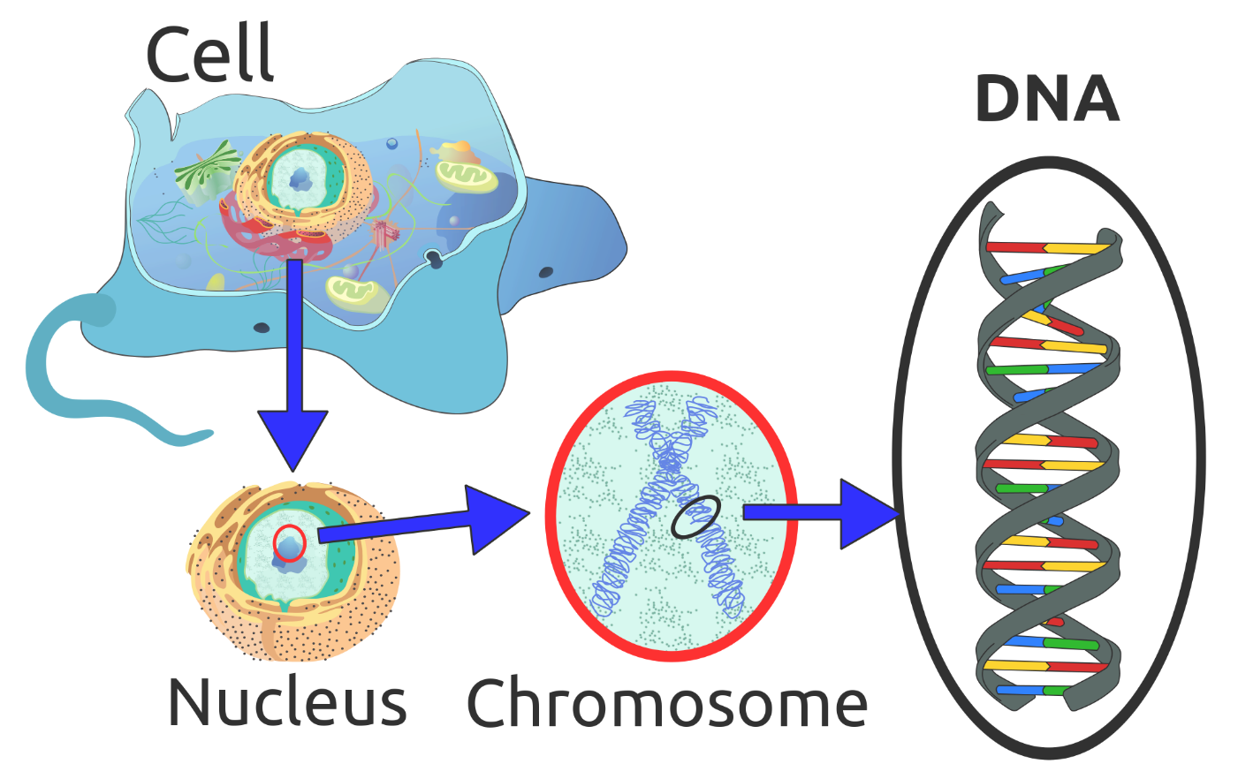
DNA
Deoxyribonucleic acid is a molecule that carries most of the genetic instructions used in the development, functioning and reproduction of all known living organisms and many viruses.

Slide 4
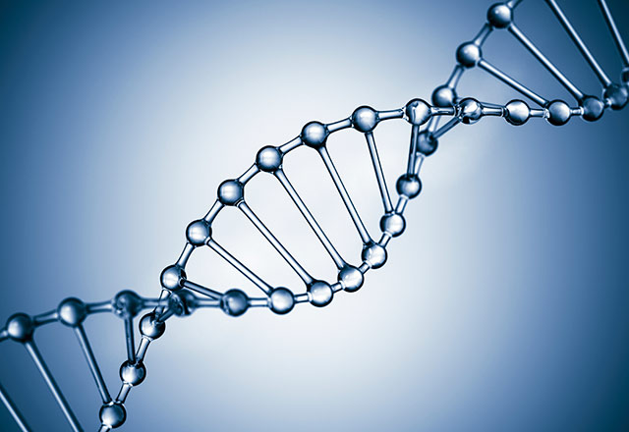
DNA is…
The informational basis for all life
Its properties allow for the storage of instructions to build living things
The building block of genes
Evolution.
The first 3 make sense, but the last one, huh?

Slide 5
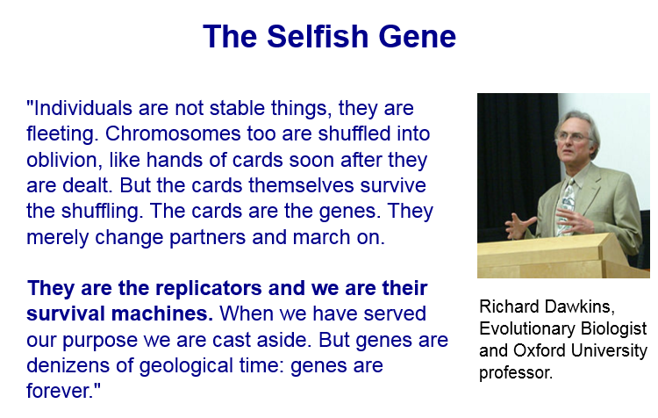

Slide 6
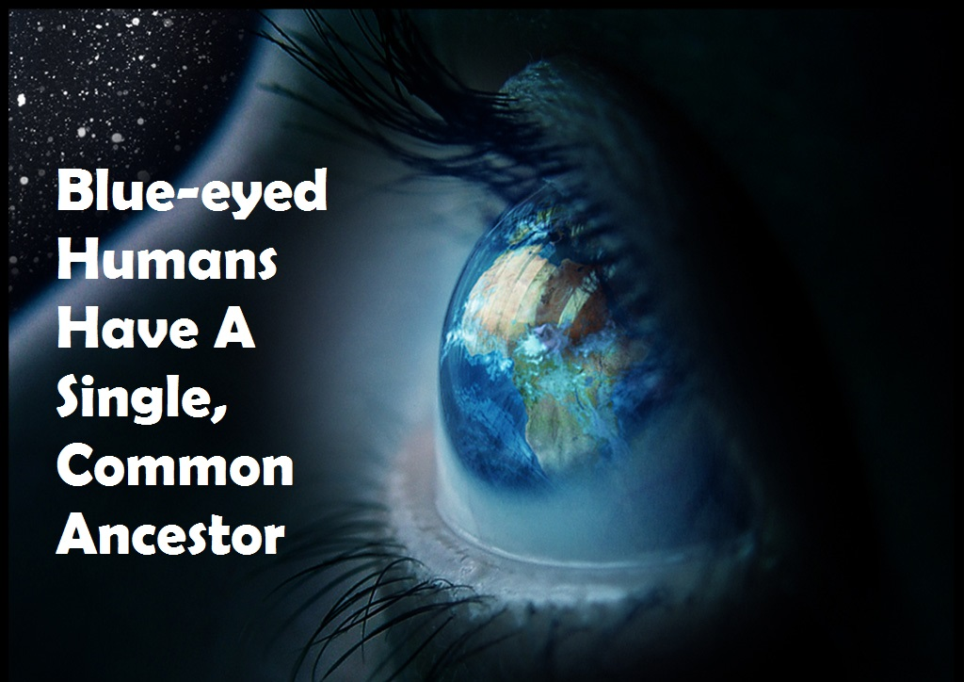
Gene for blue eyes
A mutation of one person that gave them blue eye color, has now grown into 560,000,000 (each carries 2 copies of the original mutation)

Slide 7
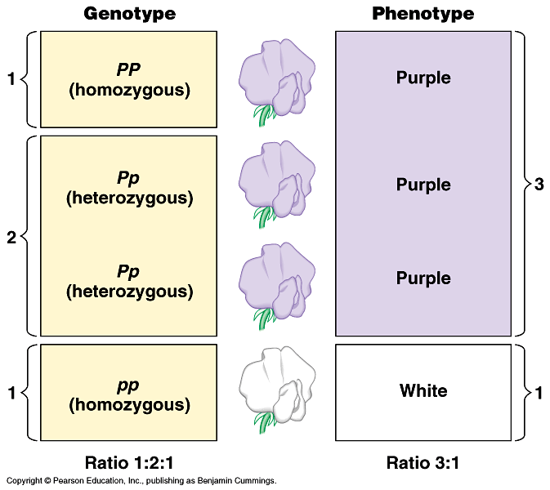
Genotype: The set of alleles, of an organism
Phenotype: The observable physical and physiological traits of an organism, (determined by its genotype)

Slide 8
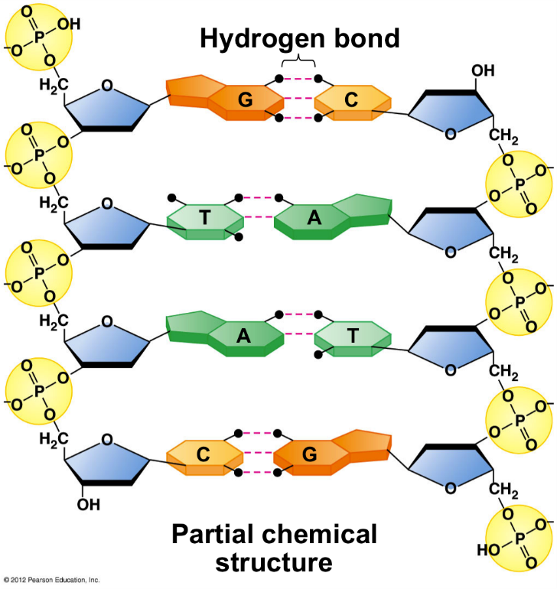
Nucleotides
The building block of a nucleic acid, consisting of a five carbon sugar covalently bonded to a nitrogenous base and one or more phosphate groups.
3 things: Sugar, Phosphate, Base
DNA is a repeating chain of nucleotides

Slide 9
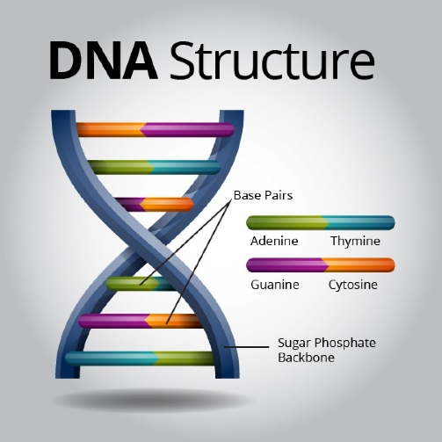
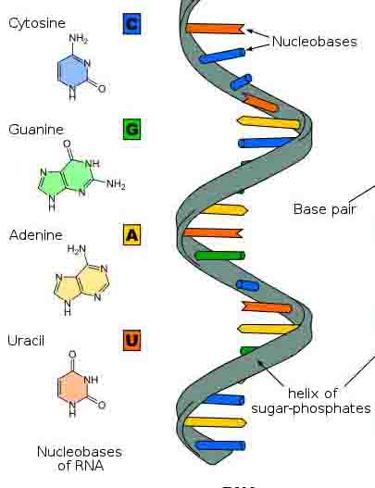
Nitrogenous Bases
DNA: Adenine – Thymine : Cytosine – Guanine
ATCGGCTTAATTCGGCGTATCGGATCTAACGTGGAACCAATTGGCGCGCTAT
RNA: Adenine – Uracil : Cytosine – Guanine
AACGUUGACGUAGUUCAAGUCCGGGUUACAACUCGACGUAGCCGUUA

Slide 10
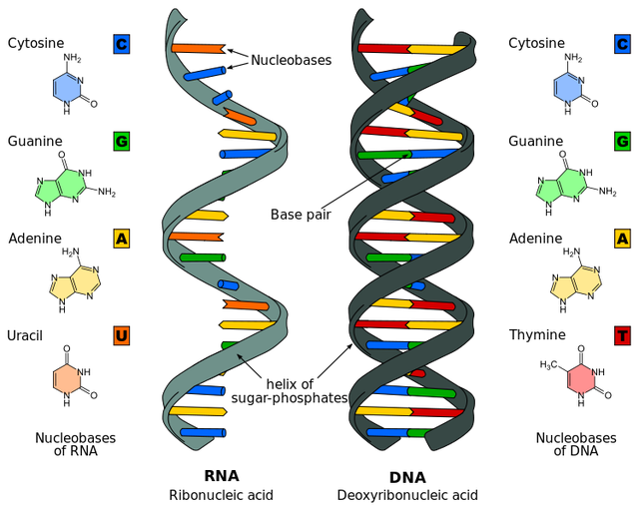
DNA vs RNA
Single vs Double
Thymine vs Uracil
DNA makes RNA
RNA makes proteins

Slide 11
Transcription
The synthesis of RNA using a DNA template
“Rewriting DNA to RNA”
DNA: TACGGATTCCCTATACACACT
RNA:

Slide 12
Translation
The synthesis of a polypeptide using the genetic information encoded in an mRNA molecule.
Codons- A three nucleotide sequence of DNA or mRNA that specifies a particular amino acid or termination signal
“Change of language from nucleotides to amino acids”
mRNA: AUGCCUAAGGGAUAUGUGUGA
Amino Acid:

Slide 13
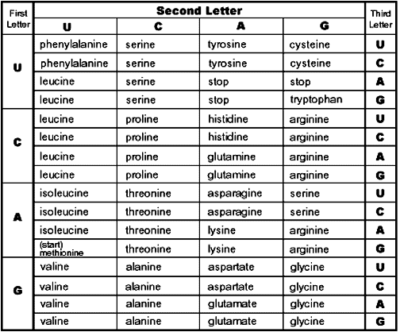

Slide 14
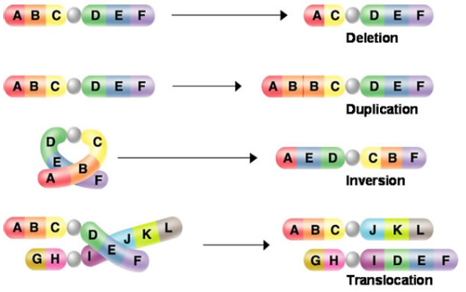
Mutations
A change in the nucleotide sequence of an organism’s DNA.

Slide 15

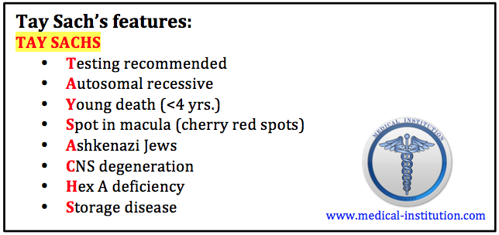
Warning: Sad Video
Tay-Sachs Disease

Slide 16

DNA Discoverers
Who are they, what are their experiments and contributions to DNA?
Friedrich Miescher
Frederick Griffith
Oswald Avery
Hershey & Chase
Rosalind Franklin
Watson & Crick

Slide 17
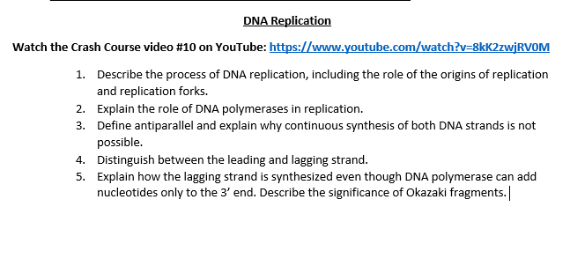
Homework

Slide 18
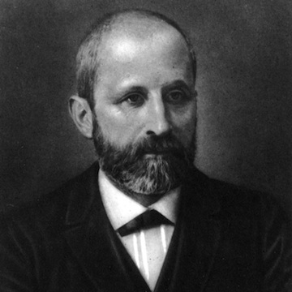
Friedrich Miescher

Slide 19
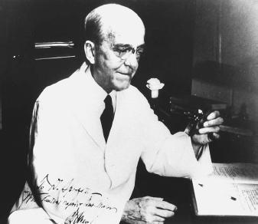
Frederick Griffith

Slide 20
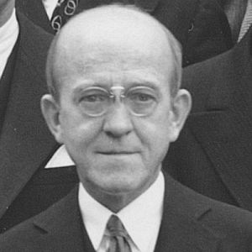
Oswald Avery

Slide 21
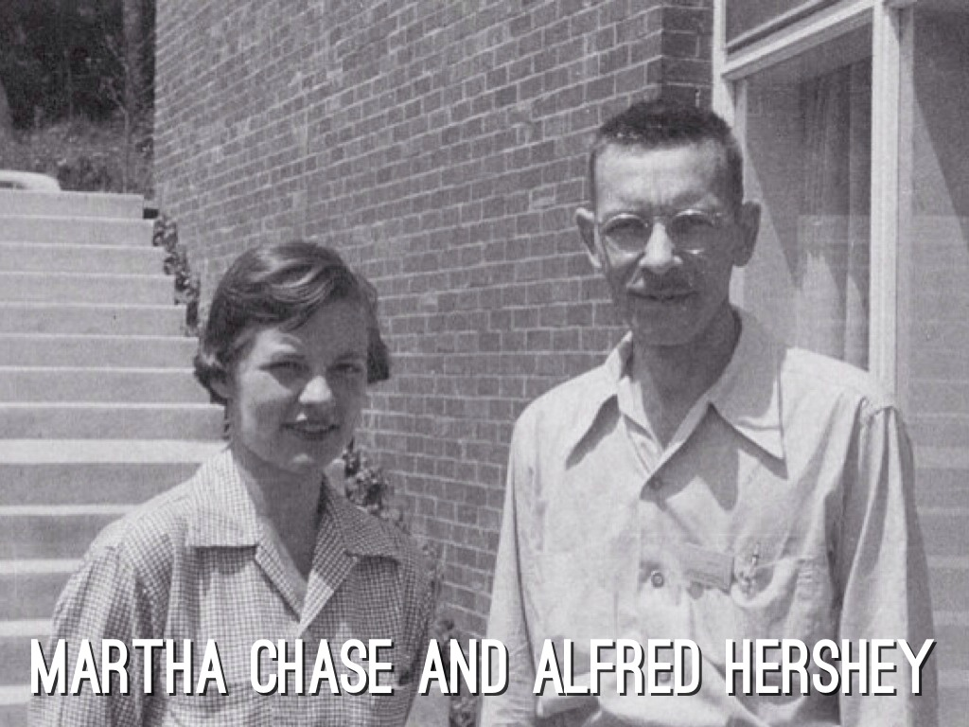
Hershey and Chase

Slide 22
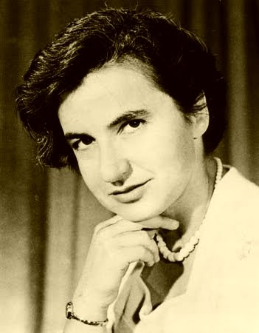
Rosalind Franklin

Slide 23
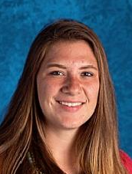
Watson and Brit

Slide 24
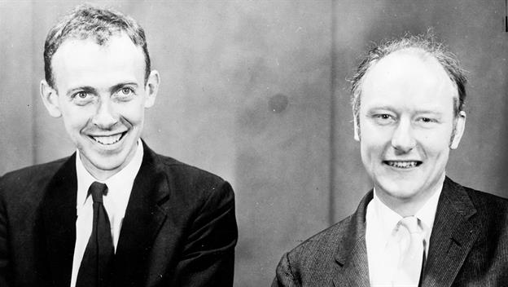
Watson and Crick

Slide 25
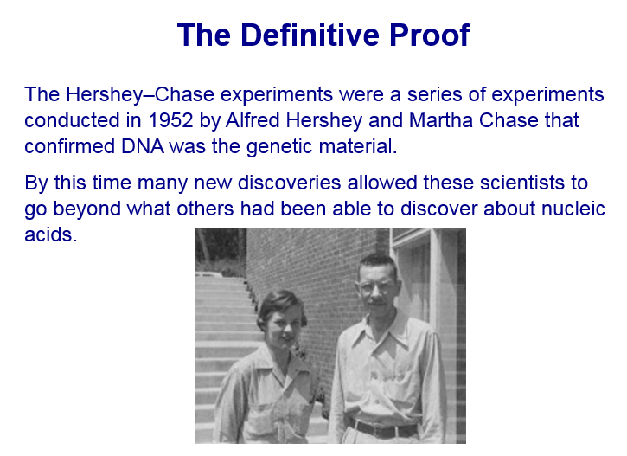

Slide 26
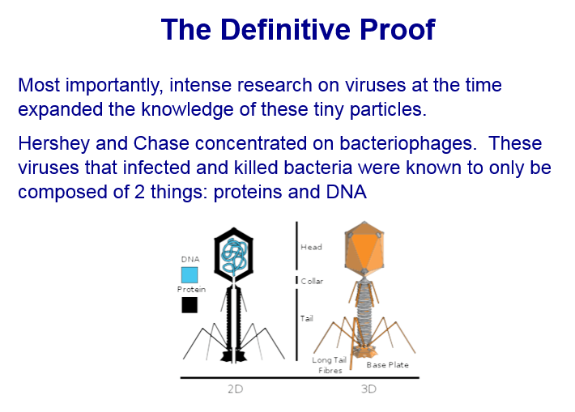

Slide 27
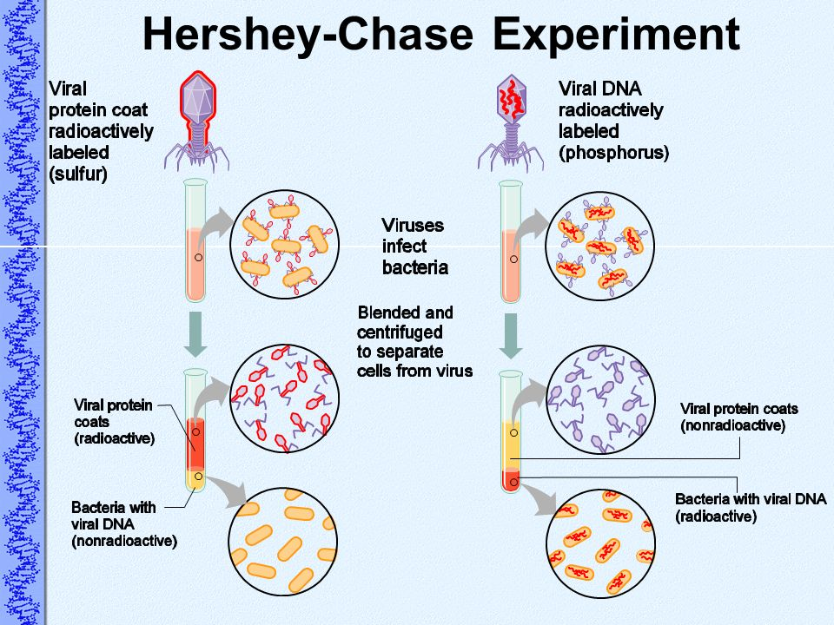

Slide 28
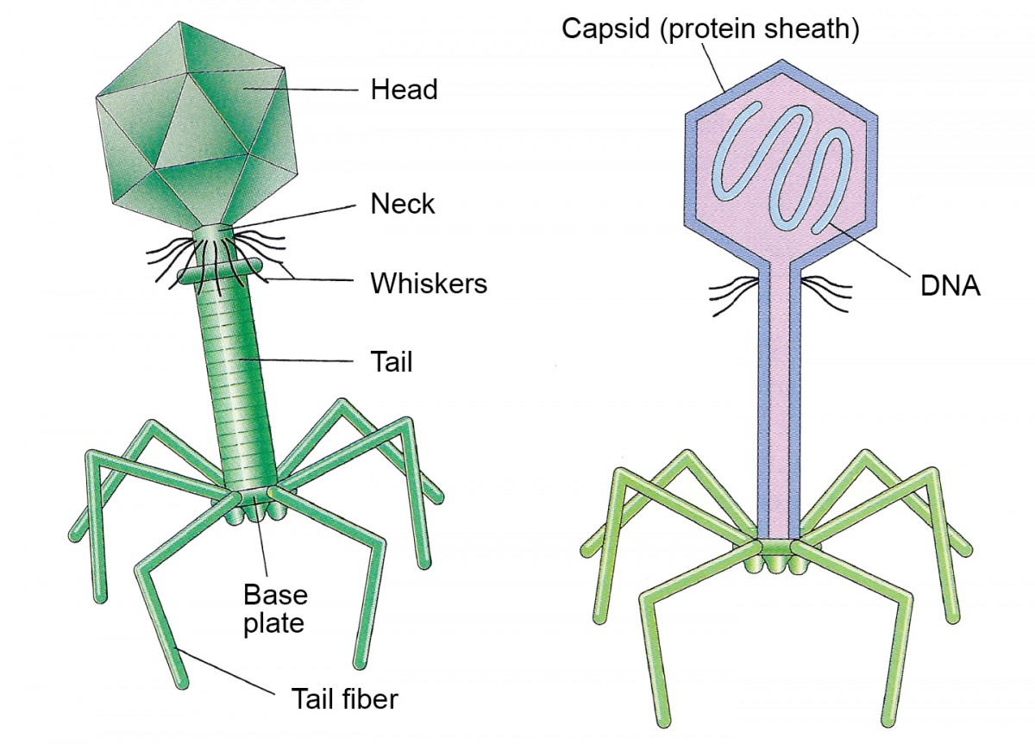
Explanation
We know that Nucleic Acids are the genetic material.
They didn’t. They thought it was either proteins or nucleic acids.
Hershey and Chase proved it was Nucleic Acids by reproducing viruses using radioactive sulfur (proteins) and phosphorus (DNA).
The “offspring virus” contained radioactive phosphorus

