Slide 1
Evolution and Natural Selection
Simpsons Evolution

Slide 2
Today’s Objective
Students can differentiate between natural selection, artificial selection, and sexual selection and can provide an example of each.

Slide 3
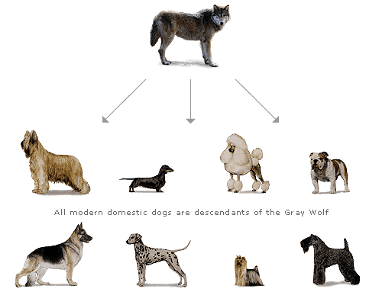
What is evolution?
Hereditary changes in groups of living organisms over time.
Key Thought: Change over time.

Slide 4
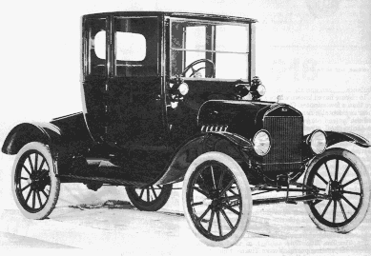
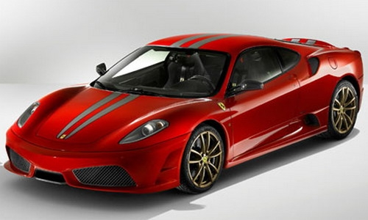
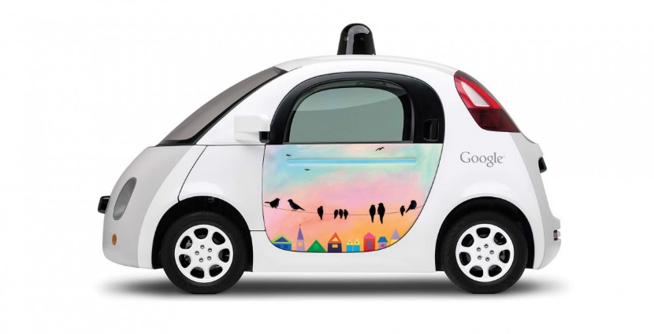
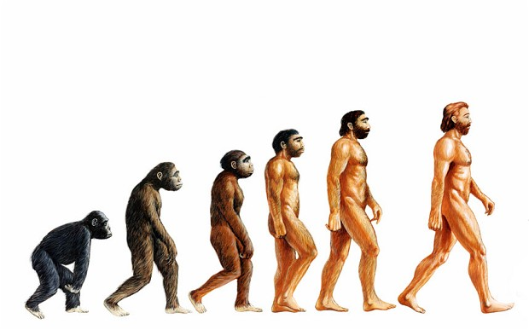
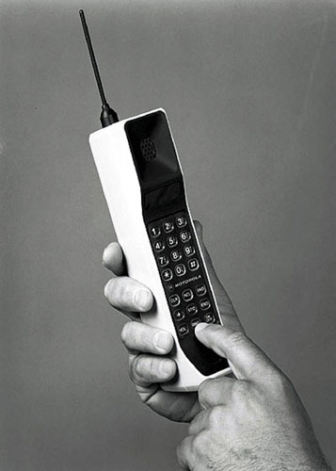

What does Evolution look like?

Slide 5
Natural Selection
Idea of Charles Darwin
    The Michael Jordan of Evolution theory
Noticed that animals of the same species had traits that benefitted their survival
Realized that these traits came about naturally (through random DNA mutations)
Successful traits were passed on through reproduction

Slide 6
Natural Selection
Idea of Charles Darwin
    The Michael Jordan of Evolution theory
Noticed that animals of the same species had traits that benefitted their survival
Realized that these traits came about naturally (through random DNA mutations)
Successful traits were passed on through reproduction

Slide 7
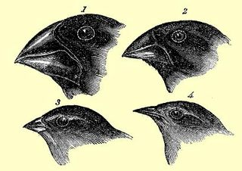
Why are these Finches different?

Slide 8
Dare to Demonstrate
Purpose: To show how finches with different beaks can eat certain foods
Materials: 1 fork, 1 spoon, 1 chopsticks
Directions: Each “finch” will have 30 seconds to compete for their own survival.
The “finch” with the least food will “die” and cannot pass on their trait.

Slide 9
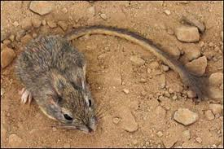
Rock Pocket Mouse
Valley of Fire
Light Sand and Dark Lava
Light and Dark mice
..\..\School Videos\natural_selection_HD.wmv by HHMI.mp4

Slide 10
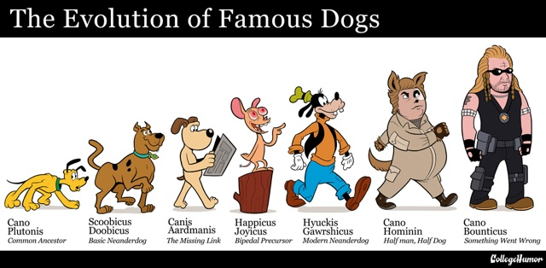
Artificial Selection

Slide 11
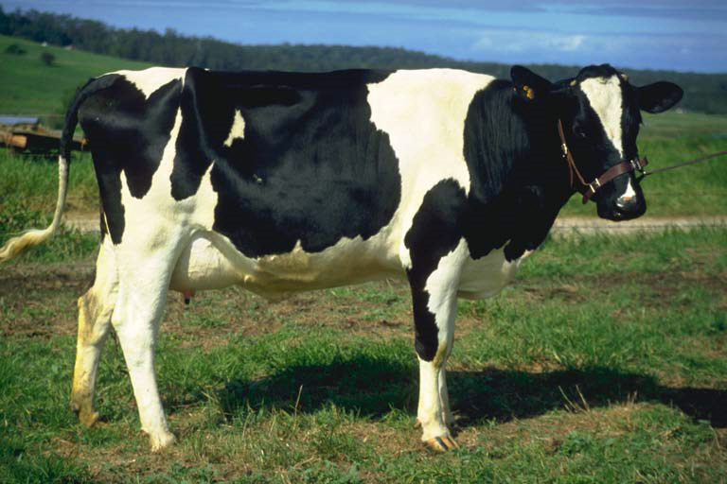
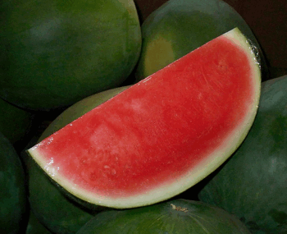
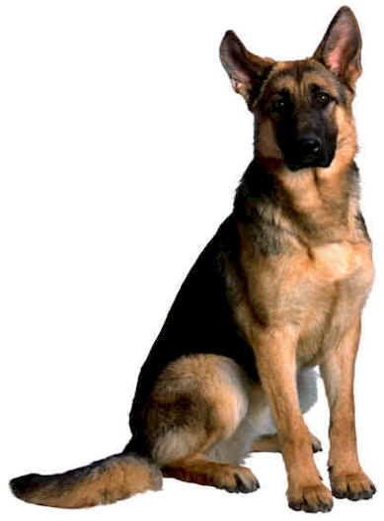

Artificial Selection

Slide 12
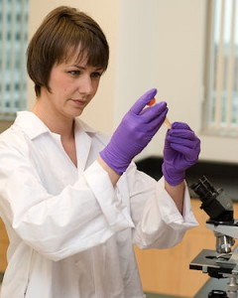
Artificial Selection
Genetically altered, man-made changes, that benefit humans
  Disease resistant vegetables
  High producing dairy cattle
  Dog breeds

Slide 13
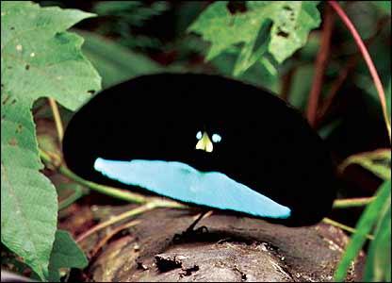
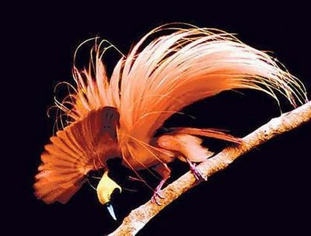
Sexual Selection
Planet Earth Jungle Clip

Slide 14
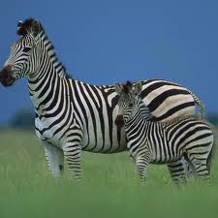
Sexual Selection
Traits are chosen by reproductive partners based on survivability
Evolution by choice through reproduction
New traits are mixed and passed on
Offspring exhibit the new trait

Slide 15
An example of Sexual Selection
Birds of Paradise from Rain Forest in New Guinea
Planet Earth Birds of Paradise

Slide 16
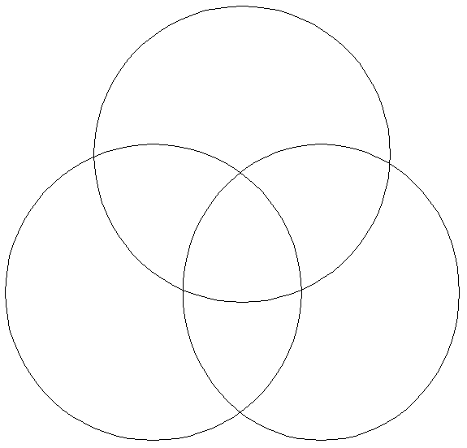
Natural
Artificial
Sexual

Slide 17
Who is Lamarck?
Lamarck’s theory came before Darwin, he thought that animals evolved because they needed to.
Unlike Darwin who said this just was random.
Did the giraffe get its’ long neck so it could reach food in trees
Or just a genetic mutation

Slide 18
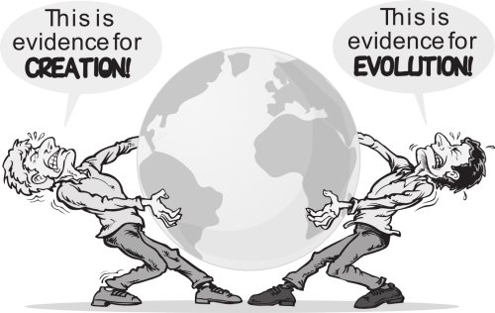
The Evolution Debate
Why is there debate about evolution?
What are the points of view of each side?
We are not here to tell you which is right or wrong!
Evolution is a scientific theory…

Slide 19
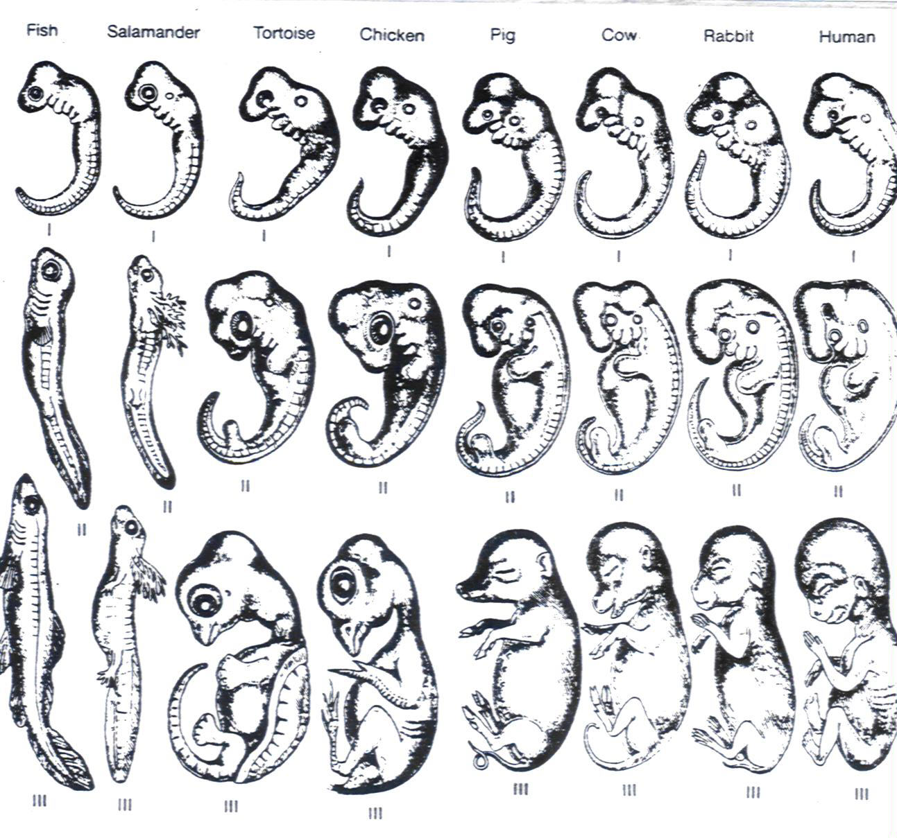
What science believes…

