Slide 1
Darwin’s Principles

Slide 2
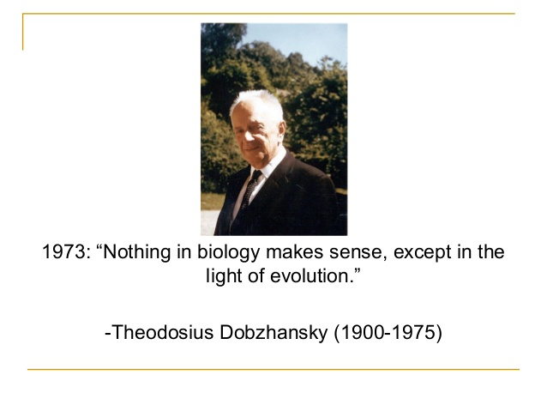

Slide 3
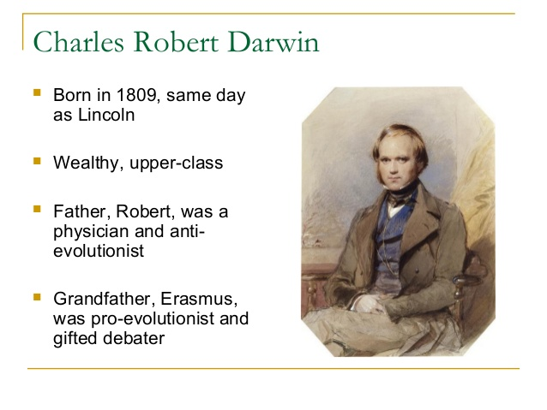

Slide 4
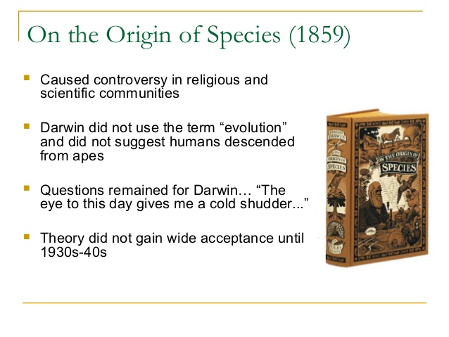

Slide 5
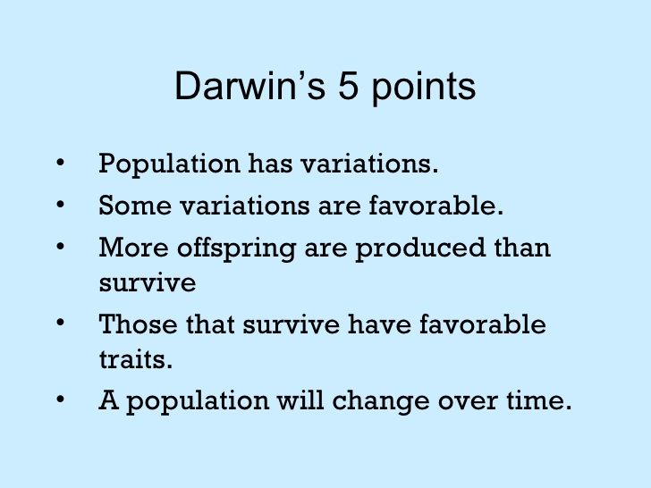

Slide 6
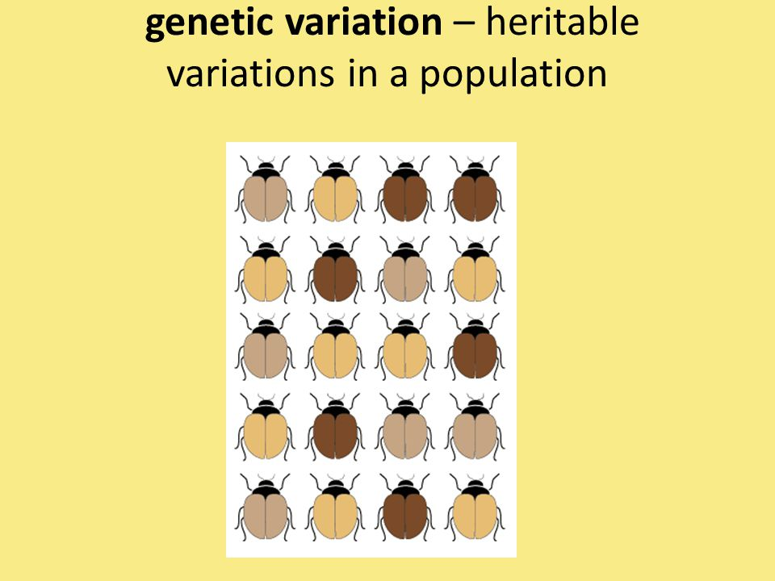
Variations in Populations
Stabilizing Selection
Directional Selection
Disruptive Selection

Slide 7
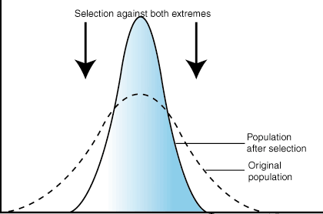
Stabilizing Selection

Slide 8
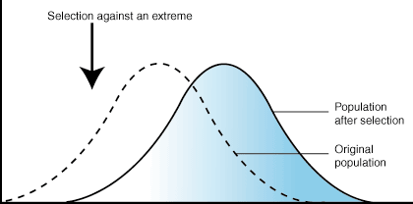
Directional Selection

Slide 9
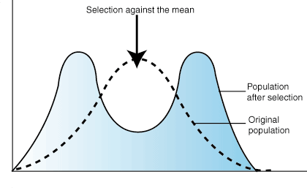
Disruptive Selection

