Slide 1
Mitosis

Slide 2
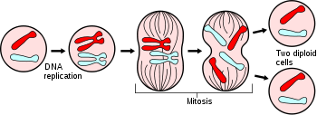
What do you already know?
What is mitosis?
Why does it happen?
What predictions can you make?

Slide 3
Objective
Students will know the steps of mitosis in order by practicing drawing the different phases on their dry erase board.

Slide 4
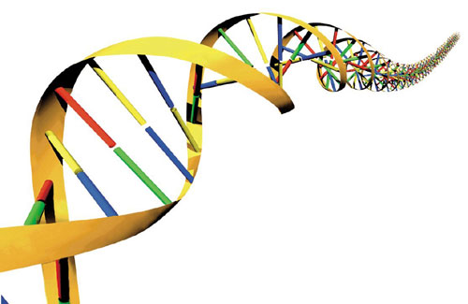
Terms you already know
Eukaryote
Nucleus
Terms you may have heard
Chromosome
Mitosis

Slide 5
Cell Division
Occurs in 2 main stages
1st stage- Interphase
2nd stage- Mitosis

Slide 6
Key ideas
Prior to cell division: chromosomes are replicated (this is Interphase)
Each chromosome consists of 2 identical “sister chromatids”
When a cell divides: sister chromatids separate and one chromatid goes to each of the two new cells

Slide 7
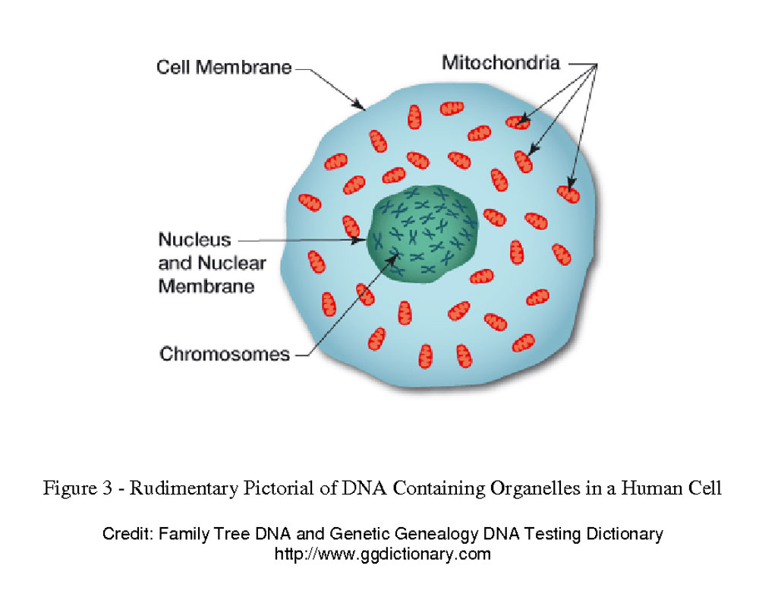
Chromosomes
Genetic material- DNA
Human cells- 46 / 23 pairs
1 from Mom / 1 from Dad

Slide 8
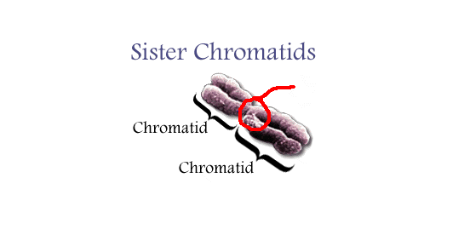
Centromere
Centromere
Chromatid

Slide 9

The Cell Cycle
The cell grows
Replicates its DNA
Divides into 2 daughter cells

Slide 10
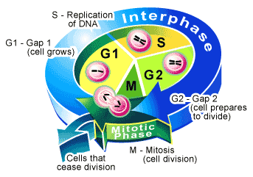
Interphase

Slide 11
Interphase
3 phases: G1/ S/ G2
G1: cell grows and makes new proteins and organelles
S: DNA replication, (chromosomes need to make a full copy of themselves before dividing)
G2: Many organelles and molecules required for cell division are produced
After G2 the cell is ready to divide.

Slide 12
The Basic Idea

Slide 13
The steps of mitosis
Remember P M A T
Prophase
  Prometaphase
Metaphase
Anaphase
Telophase

Slide 14
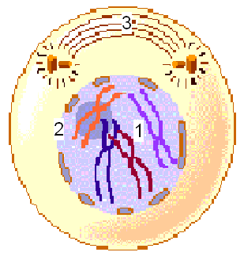
Prophase
The first and longest phase of mitosis
May take as much as 50 to 60 percent of the total time required to complete mitosis
During prophase, the chromosomes become visible
The chromosomes coil
The nuclear membrane disintegrates
Spindle fibers (microtubules) form

Slide 15
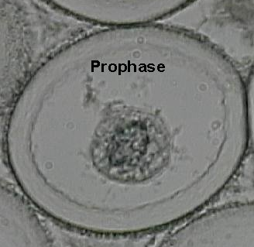
Prophase

Slide 16
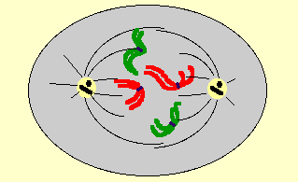
Newly Added- Prometaphase
The nuclear membrane has completely disintegrated
The spindles begin to move toward the centromeres
Chromosomes move toward the middle of the cell

Slide 17
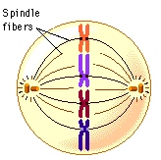
Metaphase
The second phase of mitosis
Often lasts only a few minutes
During metaphase, the chromosomes line up across the center of the cell
Microtubules connect the centromere of each chromosome to the two poles of the spindle
The chromosomes become aligned

Slide 18
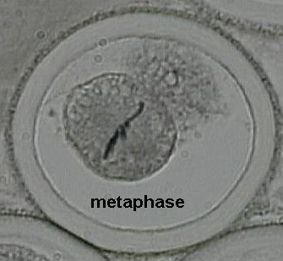
Metaphase

Slide 19
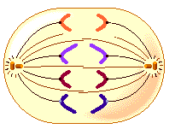
Anaphase
The third phase of mitosis
During anaphase, the centromeres that join the sister chromatids split, allowing the sister chromatids to separate and become individual chromosomes. The chromosomes continue the move until they have separated into two groups near the poles of the spindle
Anaphase ends when the chromosomes stop moving
The chromatids separate; The number of chromosomes doubles.

Slide 20
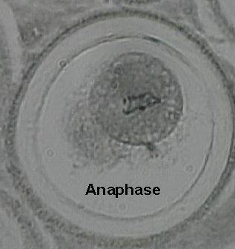
Anaphase

Slide 21
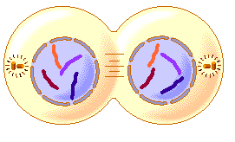
Telophase
The fourth and final phase of mitosis
In telophase, the chromosomes, which were distinct and condensed, begin to disperse into a tangle of dense material
A nuclear envelope reforms around each cluster of chromosomes
The spindle begins to break apart, and a nucleolus becomes visible in each daughter nucleus.
The cell divides into two.
The chromosomes uncoil.
The nucleus reforms.
The spindle apparatus disassembles.

Slide 22
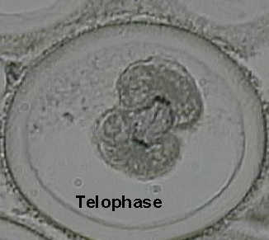
Telophase

Slide 23
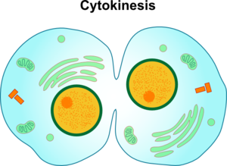
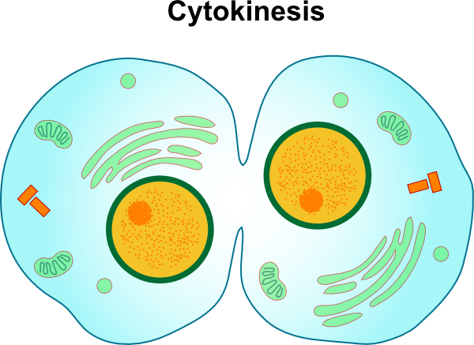
Cytokinesis
Mitosis= Nucleus Dividing
Cytokinesis= Cytoplasm dividing
Follows mitosis
How organelles are divided between new daughter cells.

Slide 24
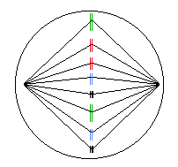
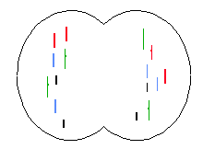
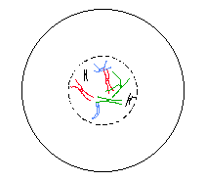
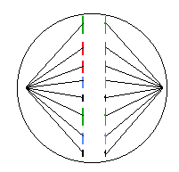
? Identify ?

Slide 25
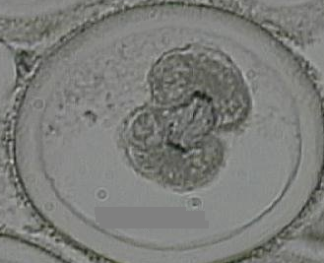
? Identify ?

Slide 26
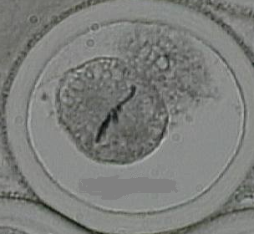
? Identify ?

Slide 27
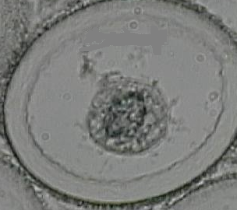
? Identify ?

