Slide 1
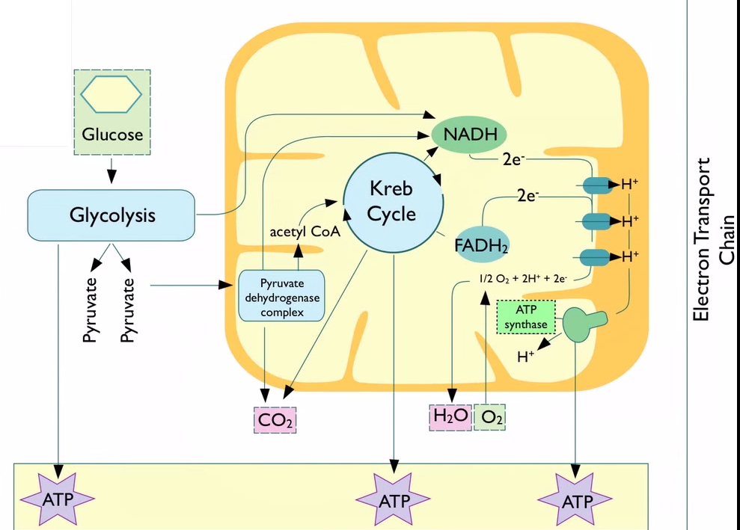

Slide 2
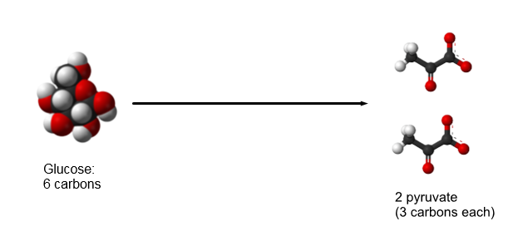
Cellular Respiration
Glucose is not a usable form of energy, it must be converted back into ATP before it can be used to do work.
The earliest form of glucose breakdown is a catabolic (breakdown) reaction known as glycolysis.
It divides a 6 carbon glucose into 2- 3 carbon pyruvates

Slide 4
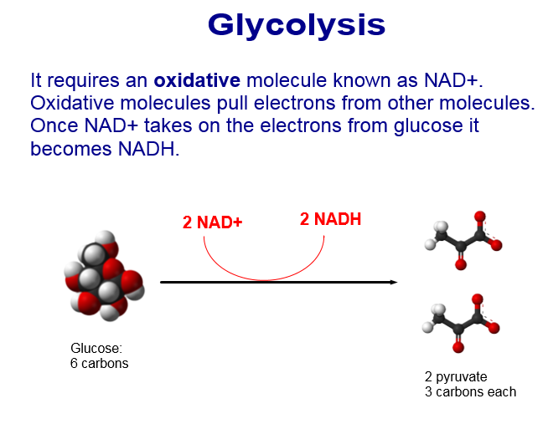
NAD+ helps to strip the electrons from other molecules
In this case Glucose- to turn it in to Pyruvate

Slide 5
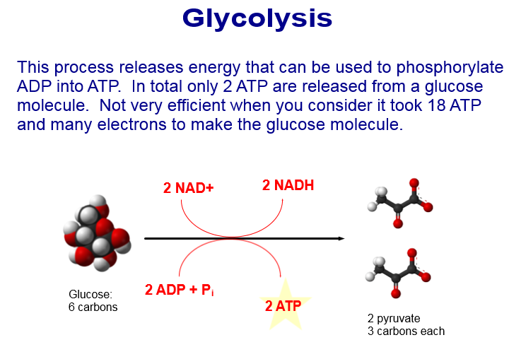
Remember that it took 9 ATP to make 1-G3P (3 carbon)
2x= 1 Glucose= 18ATP

Slide 6
Anaerobic Respiration
Anaerobic= No Oxygen
Following glycolysis if no oxygen is present, fermentation will occur.
Fermentation
Plant Cell
Animal Cell
Ethanol/ CO₂
Lactic Acid

Slide 7
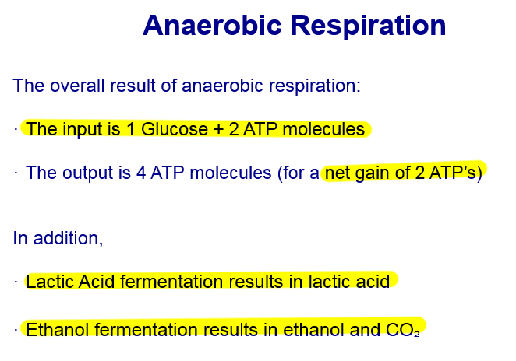

Slide 8
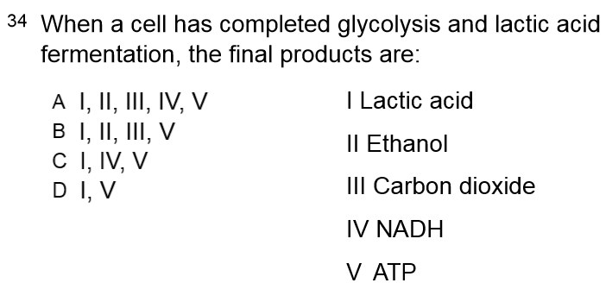

Slide 10
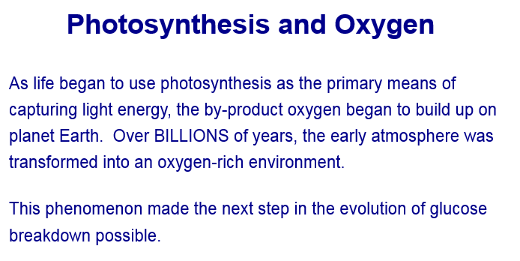

Slide 11
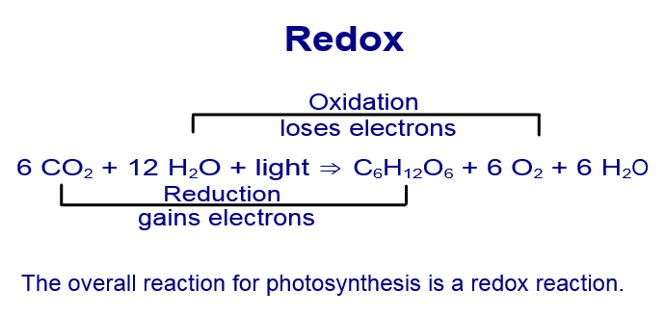
Remember Redox, One side is reducing, the other is oxidizing
LEO= Loses Electrons Oxidzies
GER= Gain Electrons Reduces

Slide 12
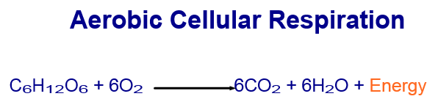
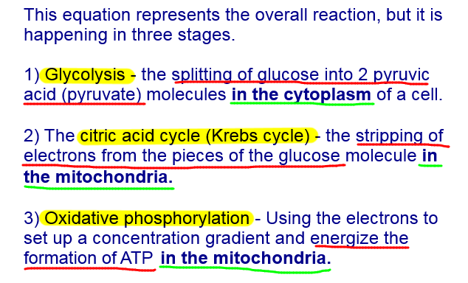
Glucose + Oxygen Carbon Dioxide + Water + ATP

Slide 13
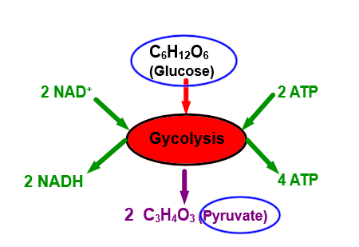
(1) Glycolysis
Occurs in the cytoplasm
Splitting of 6 Carbon Glucose into (2) 3 Carbon Pyruvates

Slide 14
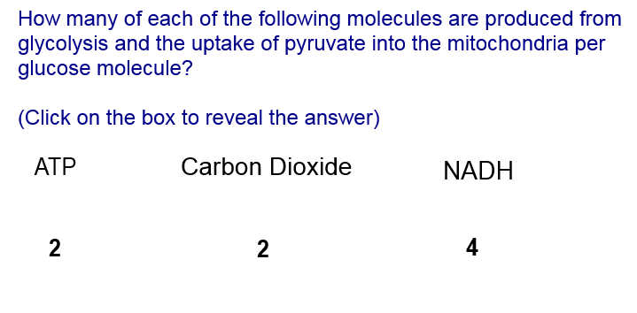

Slide 16
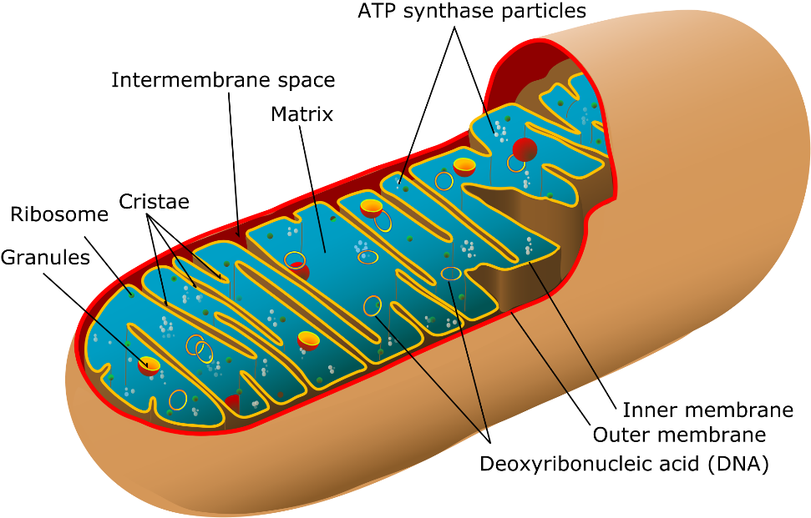
Mitochondria “Powerhouse of the blahblah…”
Organelle which specializes in the conversion of glucose into ATP
  Otherwise known as cellular respiration
They are extremely efficient, producing 36 ATP per glucose

Slide 17
Entering the Mitochondria
One at a time, the 3 Carbon Pyruvate enter the Mitochondria
Immediately, 1 Carbon is stripped from the pyruvate molecules.
The carbon leaves the system as carbon dioxide (when you exhale)
The remainder of the Pyrvuate (Now 2 carbons) is combined with a Co-Enzyme A and creates a molecule called Acetyl CoA (this occurs with the help of enzymes called PDC)

Slide 19
5. Acetyl CoA travels to the Citric Acid Cycle (aka Kreb’s Cycle)
6. This cycle completes the breakdown of the glucose molecule
7. It includes 8 steps and produces carbon dioxide, ATP, NADH, and FADH₂

Slide 20
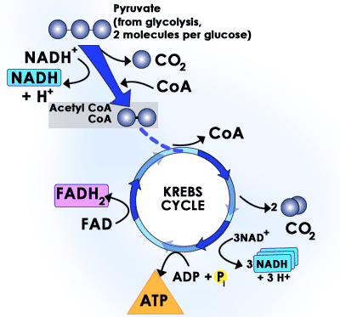
Kreb’s Cycle
One Cycle = One Acetyl CoA
2 cycles needed for 1 glucose
One turn yields:
1ATP
3NADH
1FADH₂

Slide 21
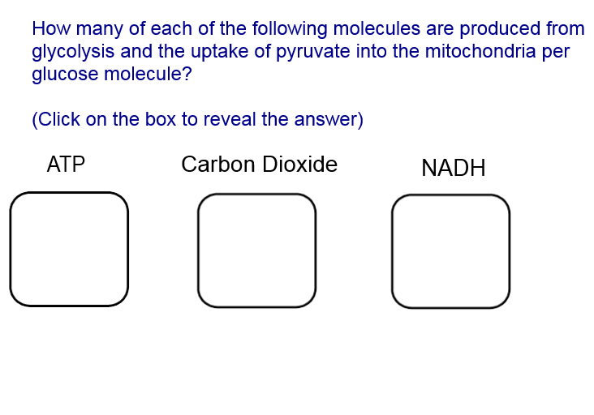

Slide 22
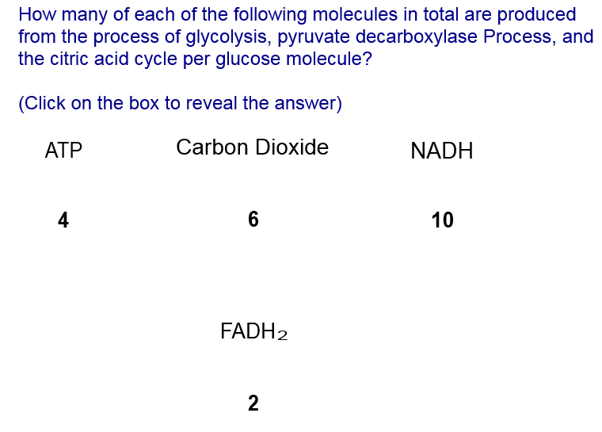

Slide 23
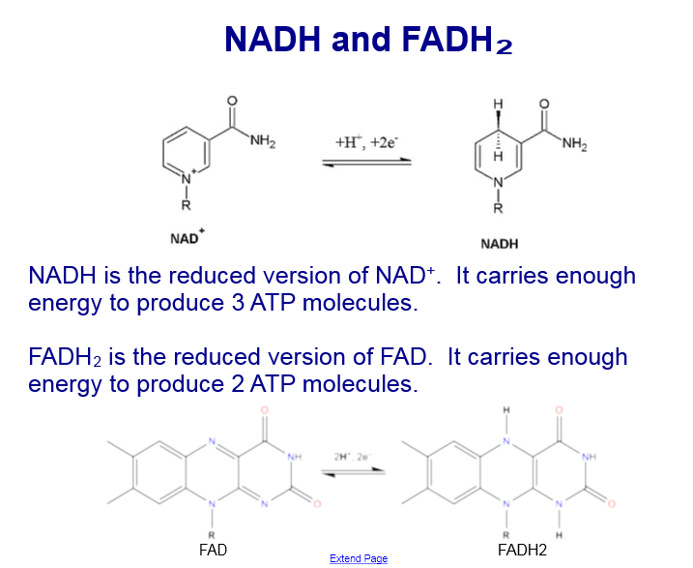

Slide 24
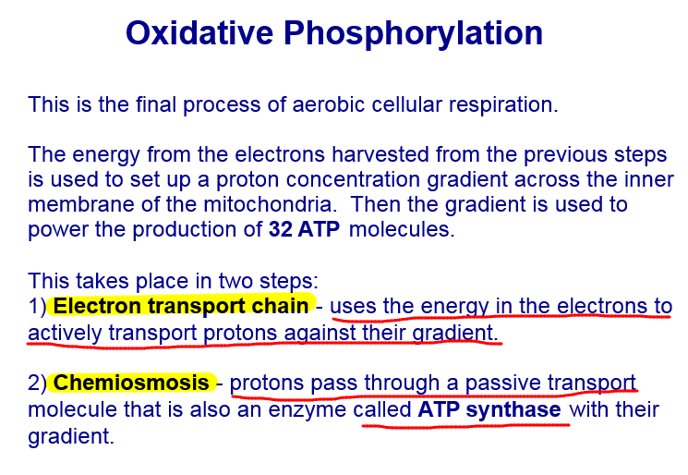

Slide 26
