Slide 1
Genetics
Pg. 253 Ch. 10.1

Slide 2
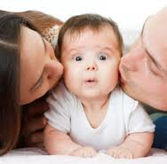
? Do Now?
Can blue-eyed parents have a baby with brown eyes? Or green eyes?
Can two tall parents have a child who is short?
Can two curly-haired parents have a child with straight hair?

Slide 3
Objective
Students are able to differentiate between a dominant trait and a recessive trait in genetics and determine through Punnett Squares which trait will be shown.

Slide 4

Gregor Mendel
The Father of Genetics (1866)
A monk who grew peas and noticed that certain pea plants produced specific traits
He crossed yellow peas with green peas and observed the differences in the offspring
Things like yellow or green, smooth or wrinkled

Slide 5
Alleles
An alternative form of a single gene passed from generation to generation
All genes have two forms
Examples: Brown hair vs. Blonde hair
Attached ears vs. unattached
Curly hair vs. straight hair
Two possibilities depend on your parents

Slide 6
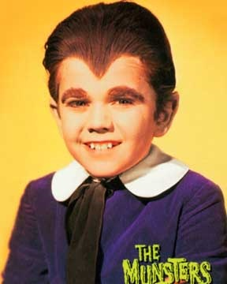

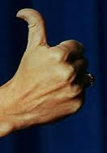
Dominant and Recessive
Dominant: the form of the trait that appears
Recessive: the form of the trait that is masked
Human Genetics Worksheet

Slide 7
Dominant Traits | Recessive Traits | You | Class
Tongue Roll | No Tongue Roll
Unattached Ear Lobe | Attached Ear Lobe
Hitchhiker's Thumb | No Hitchiker's Thumb
Chin cleft | No Chin Cleft
Widow's Peak | Normal Hairline
Brown Eyes | Gray, Green, Hazel, Blue
Curly Hair | Straight Hair
Dimples | No dimples

Slide 8
Dominant
When modeling inheritance, the dominant allele is represented with a capital letter (B)
The recessive allele is represented with a lower case letter (b)
An organism with two of the same alleles for a particular trait is homozygous (BB or bb)
An organism with two different alleles is called heterozygous (Bb)

Slide 9
Genotype and Phenotype
The organism’s allele pairs are called it’s genotype (BB) (This is what Mom and Dad gave you- genetically)
The physical appearance of an allele pair is called its phenotype (having brown eyes)

Slide 10
Punnett Square
To determine the probability of a phenotype being expressed
What are the chances that you will show the trait from your mom or dad?
Comparing 1 trait: a monohybrid cross
Comparing 2 traits: a dihybrid cross

Slide 11
Tongue Roll
T: Can roll tongue
t: Cannot roll tongue
Dad is Tt Mom is Tt | T | t
T | TT 25% | Tt 25%
t | Tt 25% | tt 25%
TT:
Tt:
tt:

Slide 12
Brown eyes
Dad is Bb Mom is BB | B | b
B | BB | Bb
B | BB | Bb
BB:
Bb:
bb:

Slide 13
Tall or Short
Dad is TT Mom is tt | T | T
t | Tt | Tt
t | Tt | Tt
TT:
Tt:
tt:

Slide 14
Hitchhiker’s thumb
Dad is Hh Mom is HH | H | h
H
H
HH:
Hh:
hh:

Slide 15
Cleft Chin
Dad is cc Mom is Cc
CC:
Cc:
cc:

Slide 16
Dad is Mom is

Slide 17
Dad is Mom is

Slide 18
Dad is Mom is

Slide 19
Comparing 2 Traits
 | RY | Ry | rY | ry
RY | RRYY
Ry | RRYy
rY
ry

