Slide 1
Enzymatic Proteins
AP Biology
Mr. LaTorre

Slide 2
Enzymes
Enzymes are proteins that act as catalysts in biological systems.
“A catalyst” What does that mean?
Youtube- Bozeman Science- Enzymes Video Explanation
https://www.youtube.com/watch?v=ok9esggzN18&feature=youtu.be
“An enzyme fits into a substrate like a lock fits into a key”
One enzyme = One substrate
Allosteric and Competitive

Slide 3
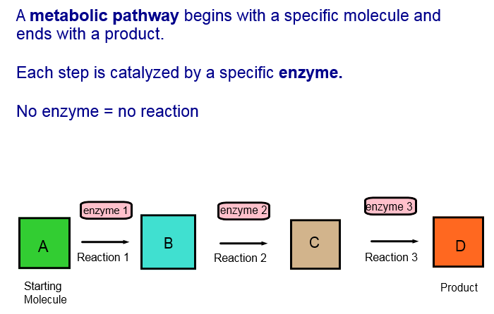
Metabolic Pathways

Slide 4
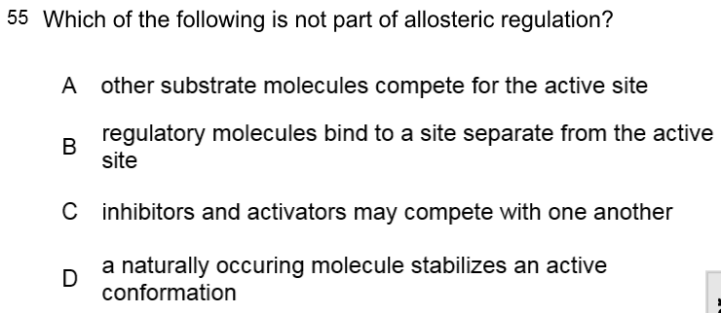

Slide 6
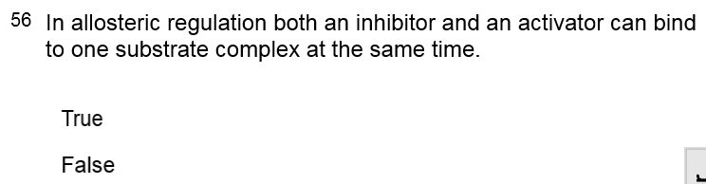

Slide 8
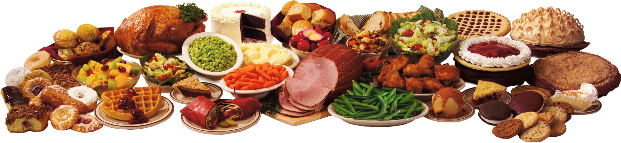
Enzymes of Digestion
Human digestion is an example of a highly complex digestion system. Humans are capable of ingesting a wide range of food, absorbing many nutrients and adjusting absorption to match intake and need.
“Numerous enzymes are involved in this process.”

Slide 9
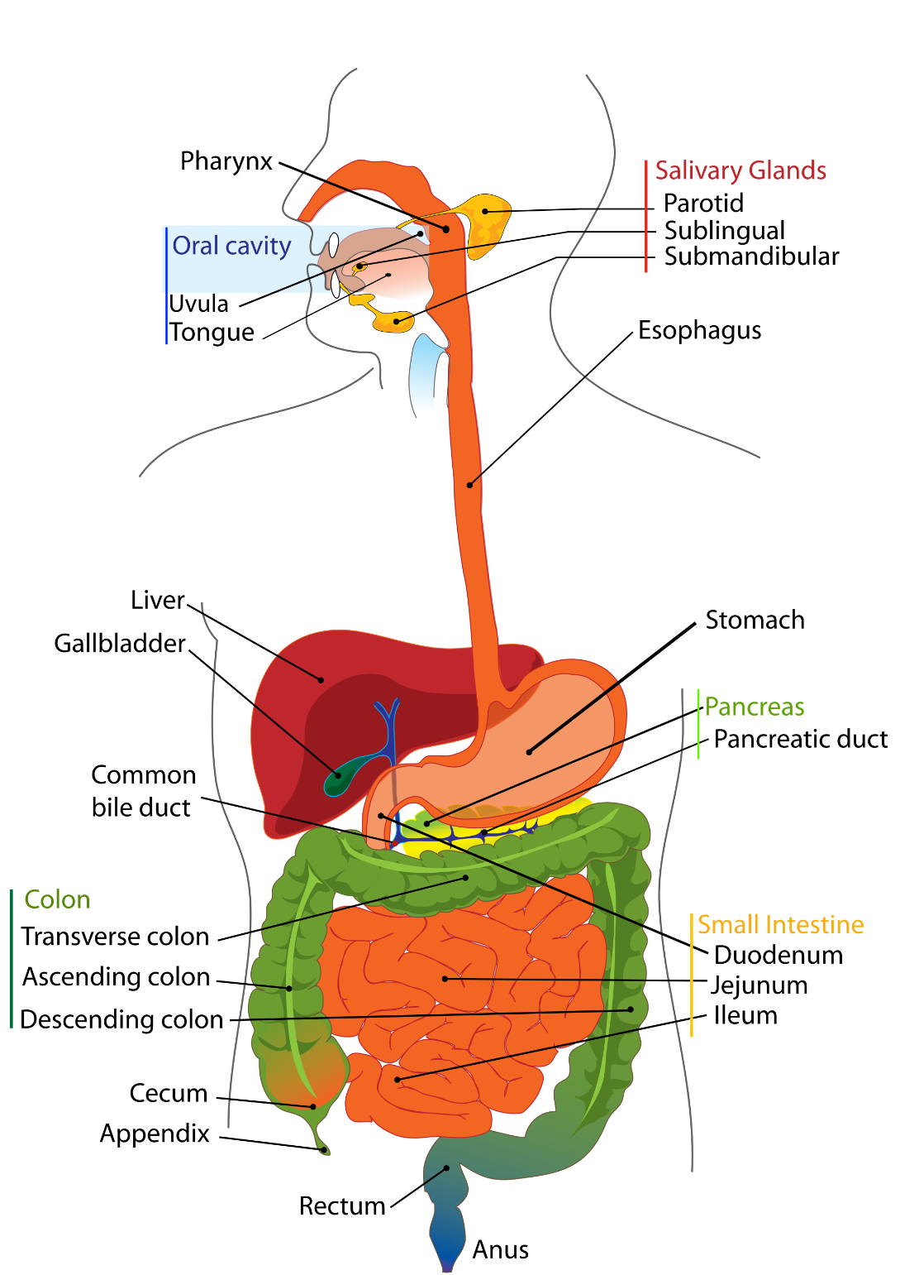
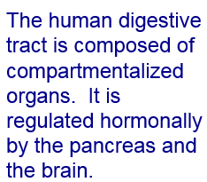
Human Digestive System

Slide 10
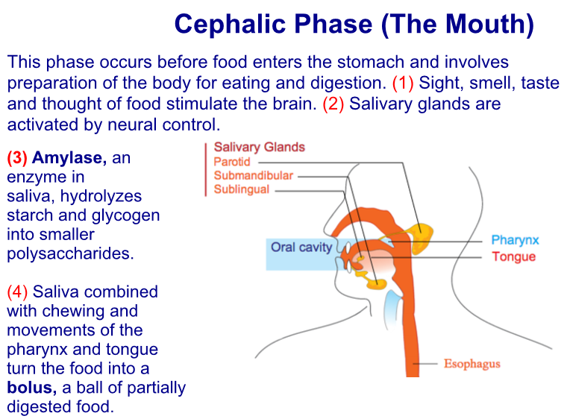

Slide 11
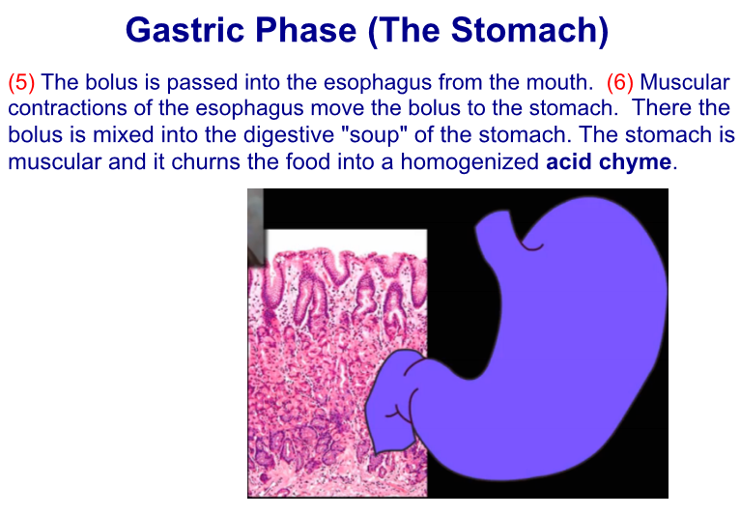

Slide 12
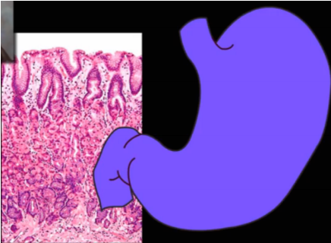
(7) The stomach produces an enzyme that becomes active in the presence of acid. To avoid destruction of stomach cells, the active enzyme pepsin is released into the lumen of the stomach as inactive pepsinogen. Another cell releases HCl to make the lumen acidic. This activates the hydrolytic enzyme pepsin.

Slide 13
(8) Chief cells produce pepsinogen, parietal produce HCl and all cells produce mucous to ensure a lining in the stomach that will protect the cells from the products they release. (9) Pepsin breaks down proteins.

Slide 14
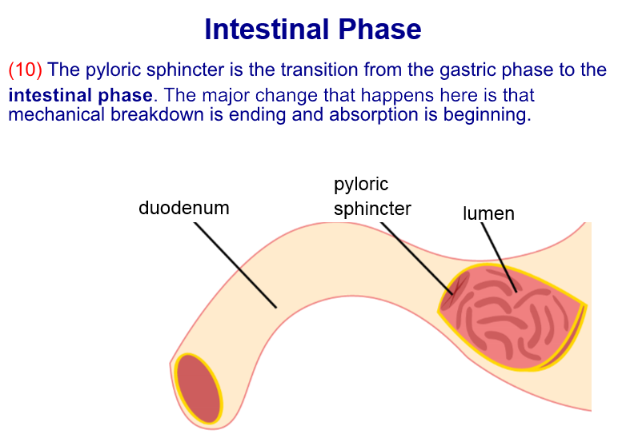

Slide 15
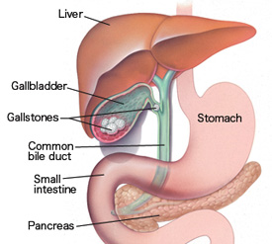
Intestinal Phase
The duodenum is the central processing area for incoming food. The
pancreas monitors the food entering the small intestine and releases
hormones that engage multi organ responses.
(11) The liver and gallbladder release bile salts that help absorb fats, carbohydrates are given one last bath of hydrolytic enzymes and the brain is alerted to the influx of nutrients.

Slide 16
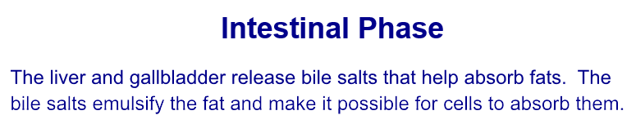
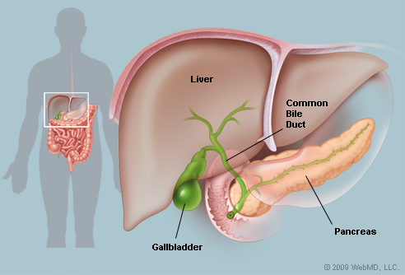

Slide 17
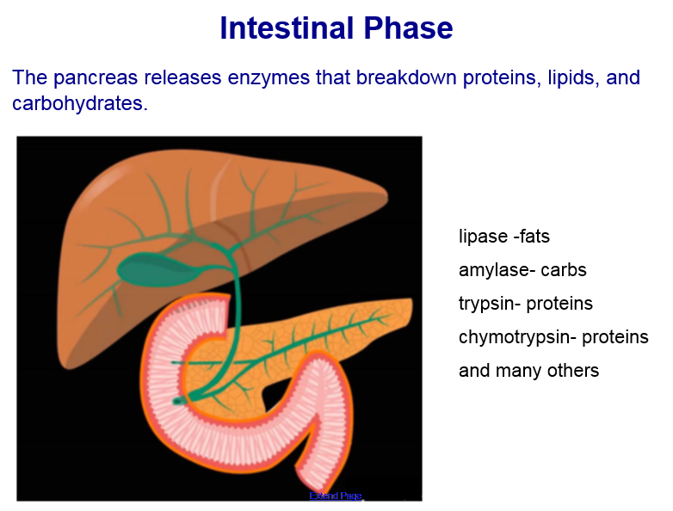

Slide 18
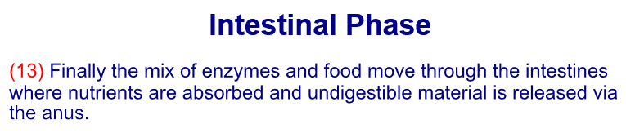
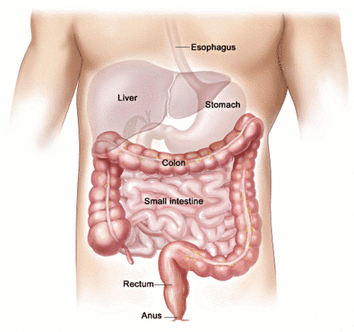

Slide 19
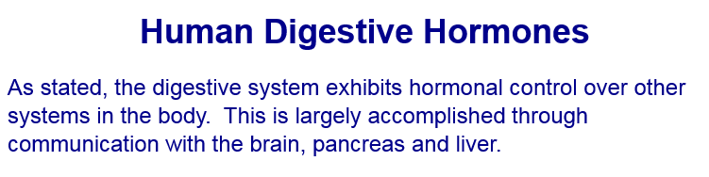
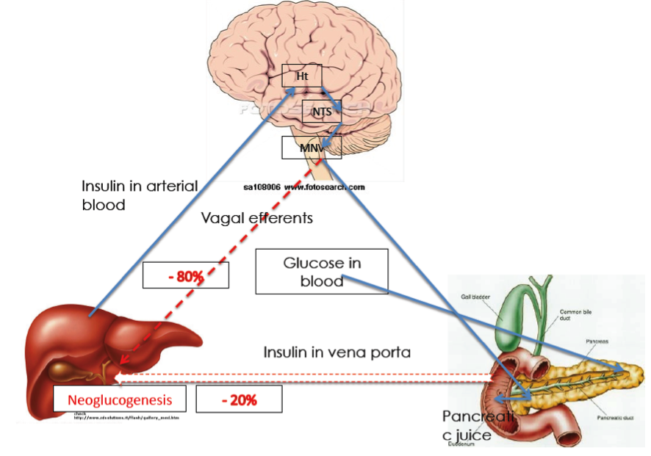

Slide 20
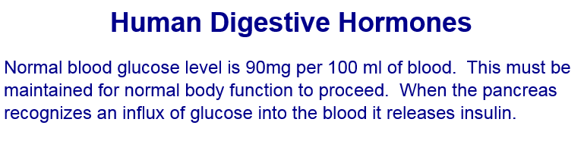

Slide 21
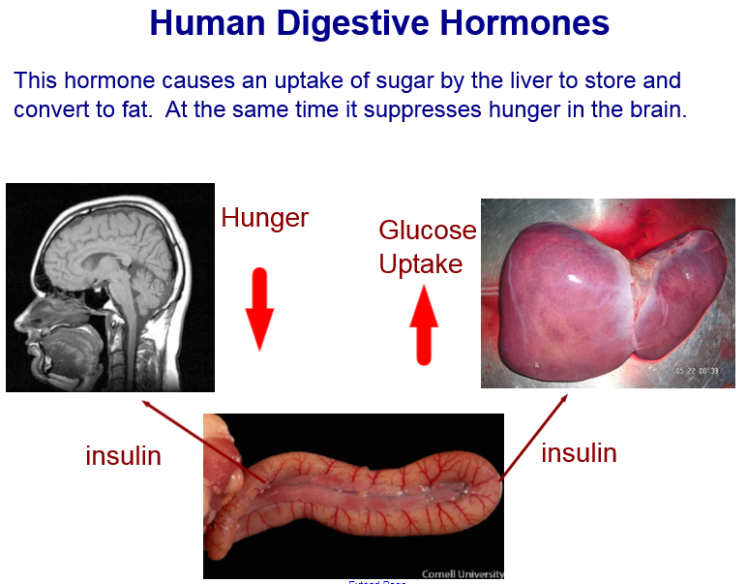

Slide 22
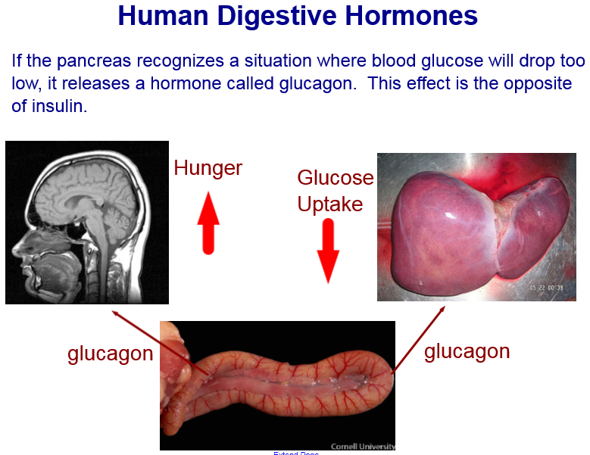

Slide 23
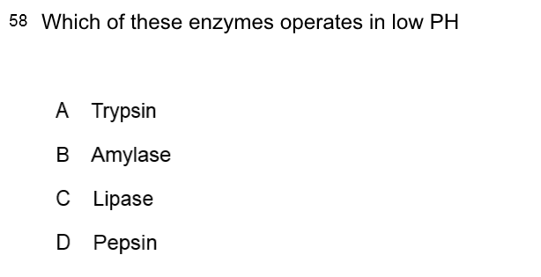

Slide 25
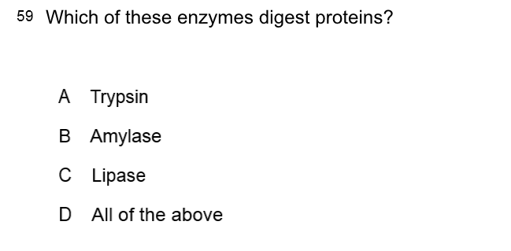

Slide 27
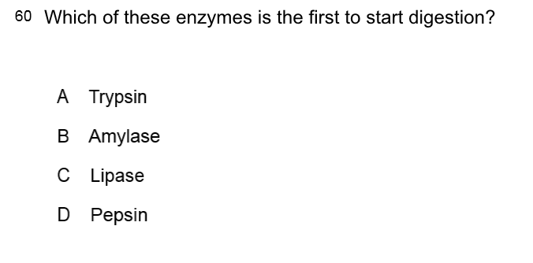

Slide 29
