Slide 1
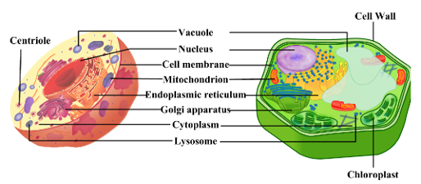
Eukaryotes: Plant & Animal Cells
Have a Nucleus and Have Organelles
Main function is to produce proteins (use endomembrane system)

Slide 2
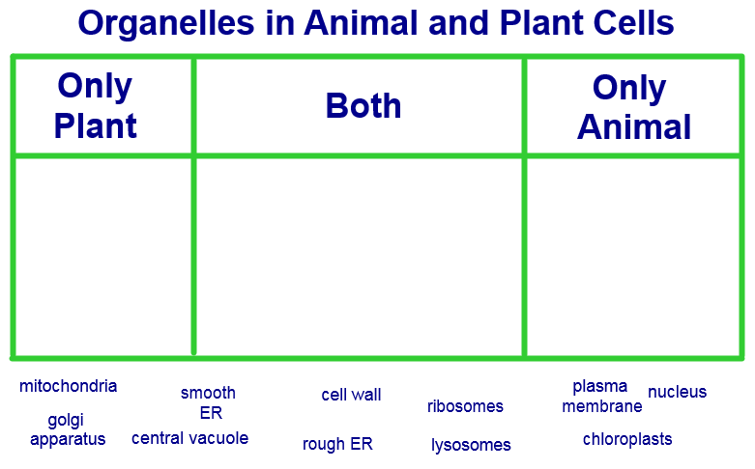

Slide 3
Organelles to Know
Nucleolus:
Nucleus:
RER:
SER:
Golgi App:
Lysosome (peroxisome):
Mitochondria:
Chloroplast:
Central Vacuole:
Plasma Membrane:
Cytoplasm:

Slide 4
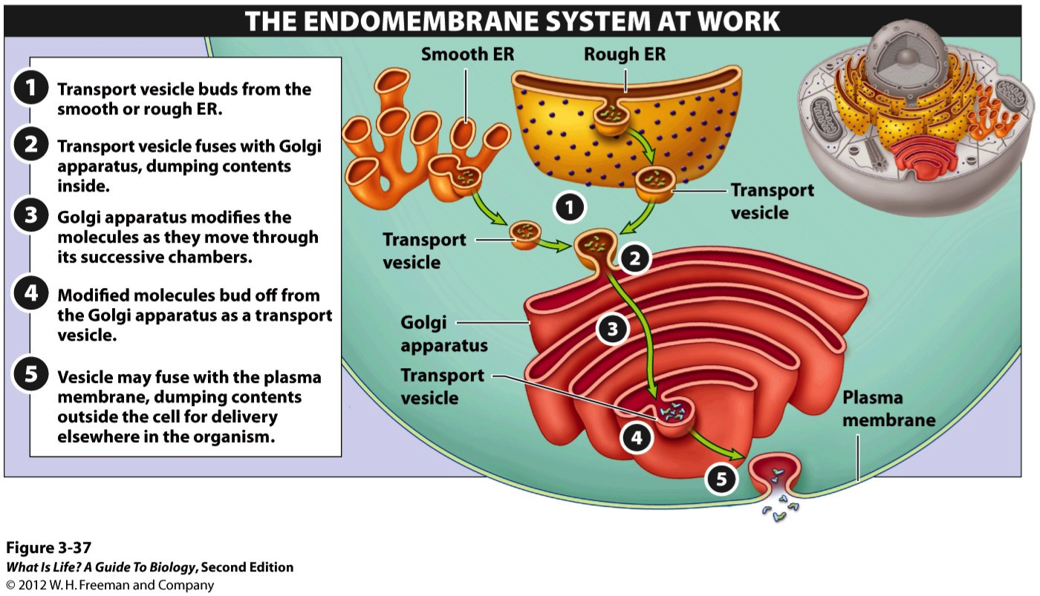

Slide 5
Endomembrane System
Nucleolus
Ribosome
Rough Endoplasmic Reticulum
Golgi Apparatus
Lysosome
Plasma Membrane
Need to know how and why.

