Slide 1
Signal Transduction
AP Biology
Mr. LaTorre

Slide 2
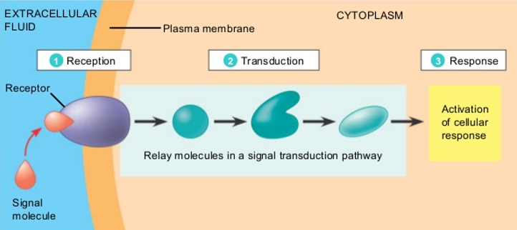
Cellular Signaling
Cellular signaling is a part of a complex system of communication that governs basic cellular activities and coordinates cell actions.
The ability of cells to perceive and correctly respond to their microenvironment is the basis of development, tissue repair, and immunity.

Slide 3
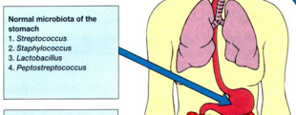
Signaling
Cells within multicellular organisms must communicate with one another to coordinate all aspects of life. Single celled-organisms also communicate with one another to perform certain symbiotic tasks.

Slide 4
Signal Transduction
Transcription factors: proteins involved in the transcription of DNA into RNA. Transcription factors initiate and regulate the transcription of genes.
“They are the response to a signal”
They cause a cell to respond to a signal in the environment in a very specific way.
The signal is anything that the cell has the ability to respond to…
Could be light, a chemical, a hormone, heat, etc.

Slide 5
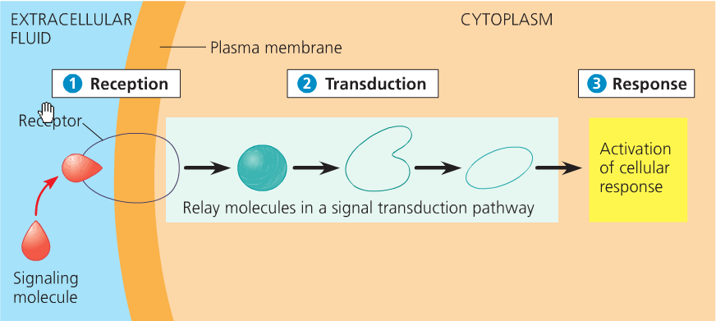
Signal Transduction Pathway
Proceeds with reception of a signal, transduction of that signal through the cell to the DNA, and finally results in expression of a transcription factor.

Slide 6
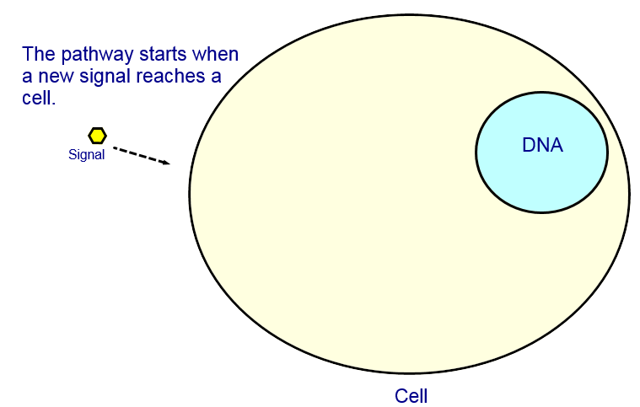
Signal Transduction Pathway
Reception

Slide 7
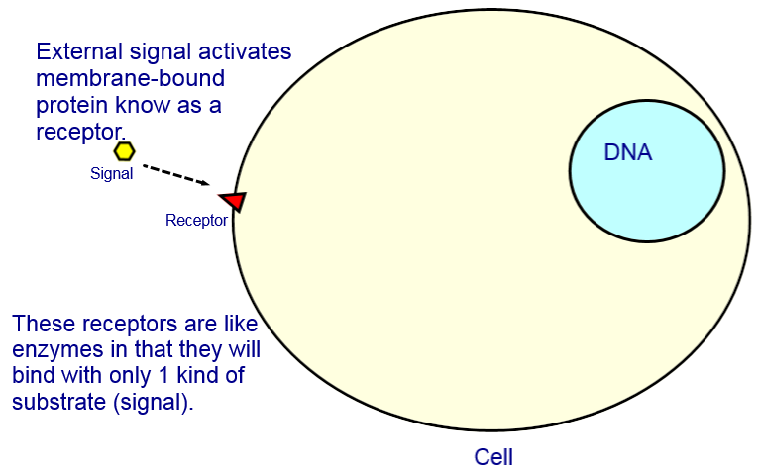
Signal Transduction Pathway
Reception

Slide 8
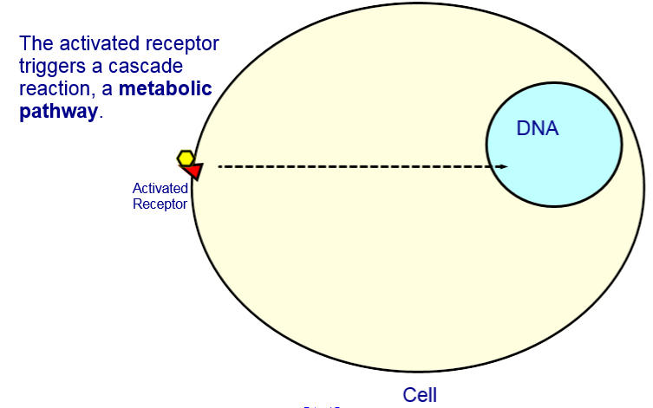
Signal Transduction Pathway
Transduction

Slide 9
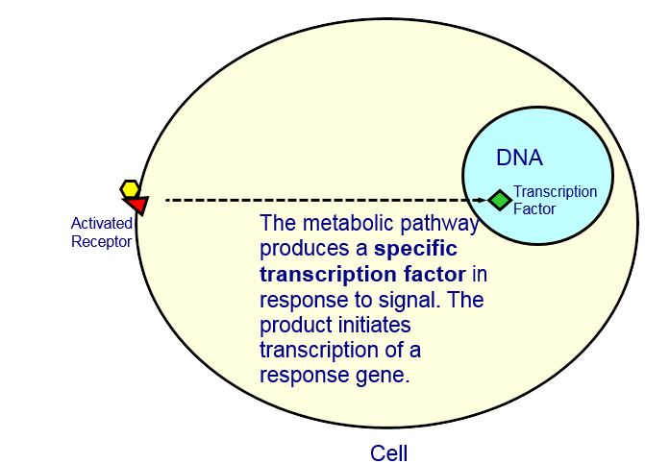
Signal Transduction Pathway
Transduction

Slide 10
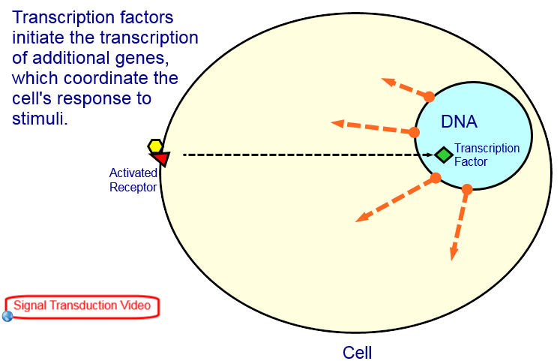
Signal Transduction Pathway
Response

Slide 11
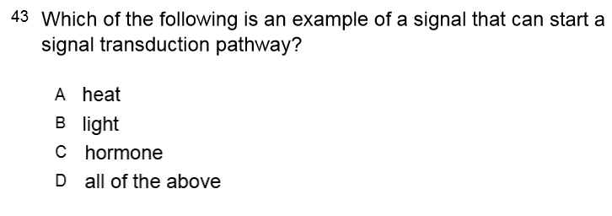

Slide 13
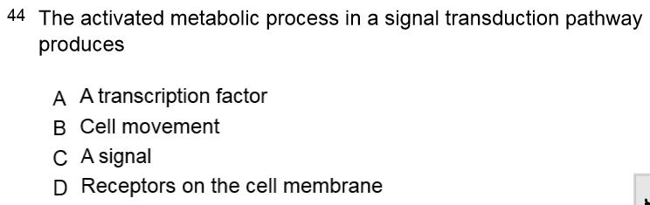

Slide 15
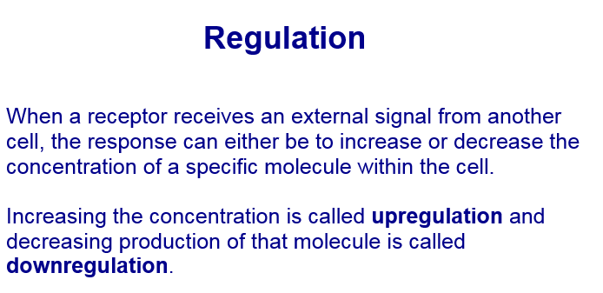

Slide 16
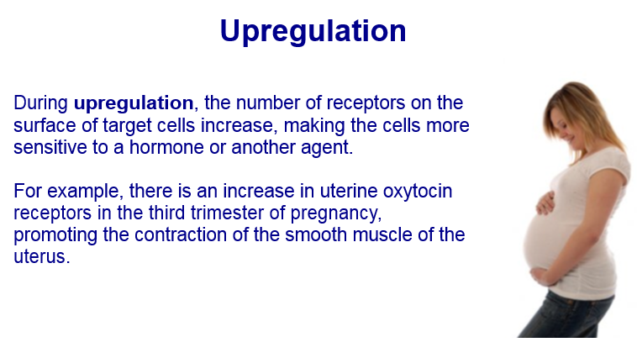

Slide 17
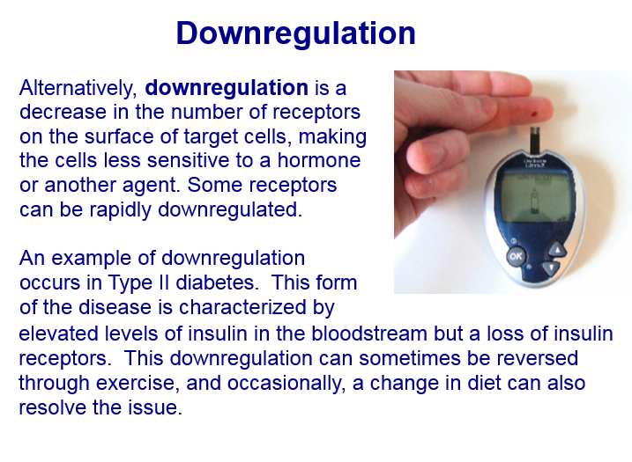

Slide 18
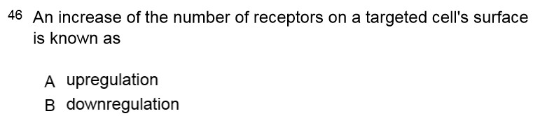

Slide 20
Analysis Questions
Explain the importance of cells being able to communicate with one another.
List the steps of a Signal Transduction Pathway.
Explain the difference between upregulation and down regulation and provide an example for each.
Find the definition of quorum sensing.

